Slide 1
Improved CRL compression with structured linear functions
Mike Hamburg
Rambus Labs
Real World Crypto 2022

Slide 2


Motivating problem: certificate revocation
CA’s signature binds a public key to some identifying information during a limited validity period
Identifies servers, devices, developers…
To verify, need:
CA’s public key to verify signature
Current time to verify validity period
Some way to know if the cert is revoked
Cert #11720:
www.bank.com’s
public key is
F0B7CCA018…
from 1 Jan 2022
to 1 Apr 2022

Slide 3
Online certificate status protocol (OCSP)
Client just asks the CA for cert status, gets a signed response
Problems!
Privacy issues, latency cost – mitigated by stapling in TLS
Single point of availability / security failure
Only works for online clients / servers, not e.g. cars
High-profile failure in 2020 for Apple developer certs
Used OCSP for code signing certs: couldn’t launch desktop apps!
Notes:
Could maybe add a comment about post quantum crypto here

Slide 4
Certificate Revocation Lists (CRLs)
CA publishes a list of revoked certs, by their serial numbers
Includes reasons for revocation
Don’t need to include expired certs
Client updates the list periodically
Can check certs privately, offline
Problem: CRLs are huge — Apple’s is 96 MB*
Can use gzip, delta encoding etc … it’s still too big
* in Sept 2021 when I ran the test

Slide 5
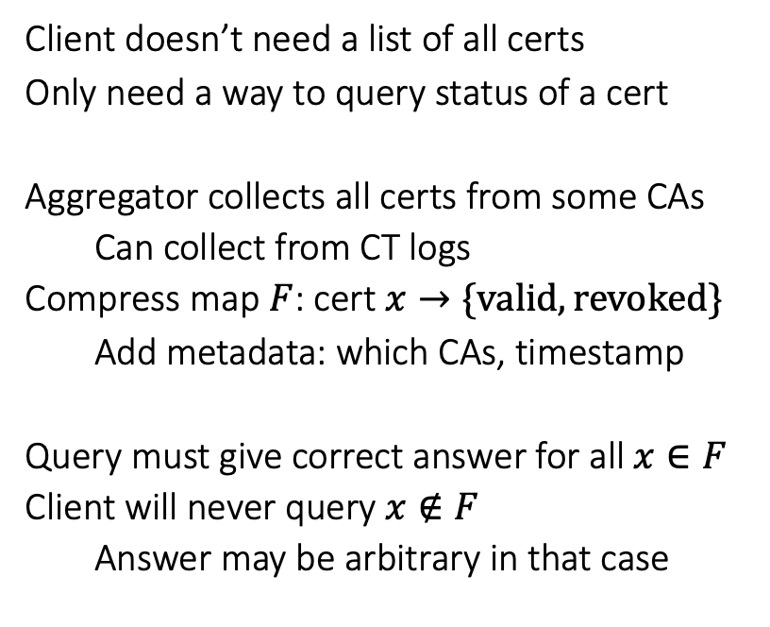
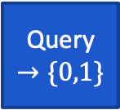
CRLite [LCL+’17] and static functions
All issued certs
Client doesn’t need a list of all certs
Only need a way to query status of a cert
Aggregator collects all certs from some CAs
Can collect from CT logs
Compress map $F$: cert$x→\{valid, revoked\}$
Add metadata: which CAs, timestamp
Query must give correct answer for all $x∈F$
Client will never query $x∉F$
Answer may be arbitrary in that case
CRL
CRL
gzip
aggregate
CA/aggregator
Client
un-gzip
static function
CRL
cert
Query $→\{0,1\}$
Is cert in CRL?

Slide 6
Structured linear functions
and specifically, frayed ribbon filters

Slide 7
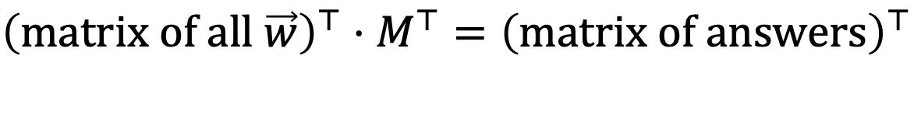
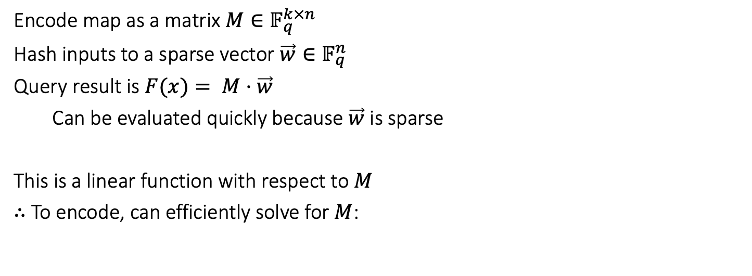
State-of-the-art static functions: structured linear functions
Encode map as a matrix $M∈𝔽_{q}^{k×n}$
Hash inputs to a sparse vector $\vec{w}∈𝔽_{q}^{n}$
Query result is $F(x)= M⋅\vec{w}$
Can be evaluated quickly because $\vec{w}$ is sparse
This is a linear function with respect to $M$
$∴$ To encode, can efficiently solve for $M$:
$${\left(matrix of all \vec{w}\right)}^{⊤}⋅M^{⊤}={\left(matrix of answers\right)}^{⊤}$$
$$M⋅\left(matrix of all \vec{w}\right)=(matrix of answers)$$
Notes:
Make note of full names of authors

Slide 8
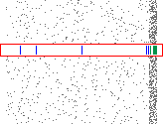
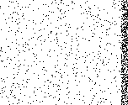
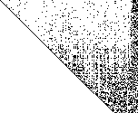
Matrix filters [DP’08] / XOR-SAT filters [WRS’18]
Each row has $k$ nonzero entries in random positions
Solve with Gaussian elimination in $O\left(n^{3}\right)$, Strassen in $O\left(n^{2.8}\right)$, Wiedemann in $O\left({kn}^{2}\right)$
Far too slow for large matrices: must break into shards

Slide 9
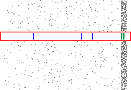
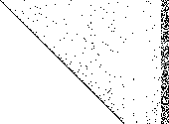
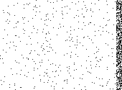
Peeling [BBD’09] / Xor filters [ML’20] / Fuse filters [ML’22]
Xor filters allocate 23% more space; can compress to 8% (xor+ filter)
Can improve to 7-13% (binary fuse filter)
Rearrange rows and columns in $O(n)$ time

Slide 10
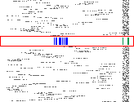
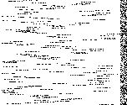
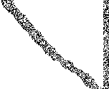
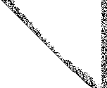
Ribbon filters [DW’21]
Each row is nonzero only in an interval of size $β=O\left(\frac{\log{n}}{δ}\right)$
Sort to banded matrix; Gaussian elimination doesn’t fill in; takes time $O(nβ^{2})$

Slide 11

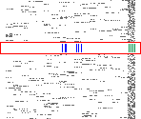

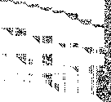

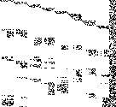

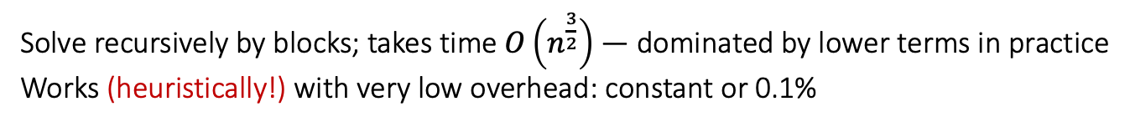
Frayed ribbon filters [new!]
Each row is nonzero only in two aligned intervals of size $β=32$, usually nearby
Solve recursively by blocks; takes time $O\left(n^{\frac{3}{2}}\right)$ — dominated by lower terms in practice
Works (heuristically!) with very low overhead: constant or 0.1%

Slide 12
Comparison to previous filters
Filter | Static fn? | Approx set? | overhead | build/item | query
Frayed Ribbon | yes | yes | 0.1%^{[1]} | 1.3µs | 68ns
Ribbon w=64 | yes | yes | 19.6% | 66ns | 48ns
Ribbon w=128 | yes | yes | 7.1% | 109ns | 63ns
Balanced ribbon w=64 | no | yes | 0.8% | 184ns | 64ns
XOR+ | yes | yes | 14.5% | 183ns | 35ns
Binary fuse 4wise | yes | yes | 7.5% | 58ns | 39ns
Bloom | no | yes | 44.4% | 30ns | 47ns
Benchmark config: using fastfilter_cpp [ML’18], calling C version of frayed ribbons using Murmur3 for fairness
10 million items, one core of MacBook Pro 13”, 2.4 GHz Core i5-8279U, 16 GiB RAM
[1] The output shows 0.3% instead of 0.1% as an artifact of how fastfilter_cpp conducts its tests.

Slide 13
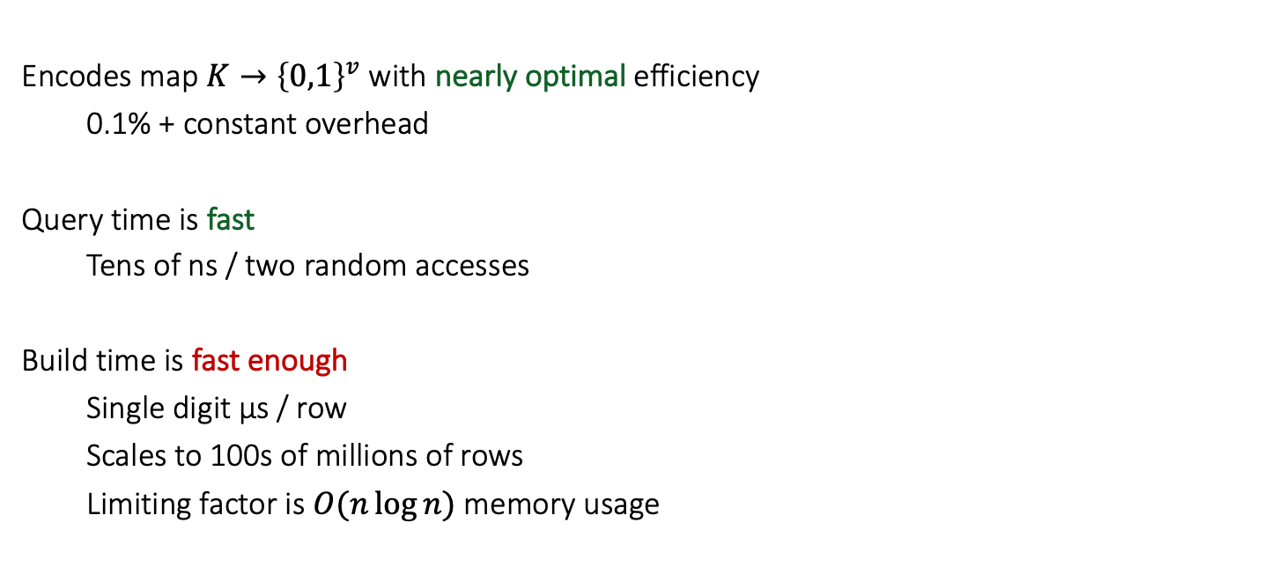
Frayed ribbon filters: summary
Encodes map $K→{\left\{0,1\right\}}^{v}$ with nearly optimal efficiency
0.1% + constant overhead
Query time is fast
Tens of ns / two random accesses
Build time is fast enough
Single digit µs / row
Scales to 100s of millions of rows
Limiting factor is $O(n\log{n)}$ memory usage

Slide 14
Filter cascade

Slide 15
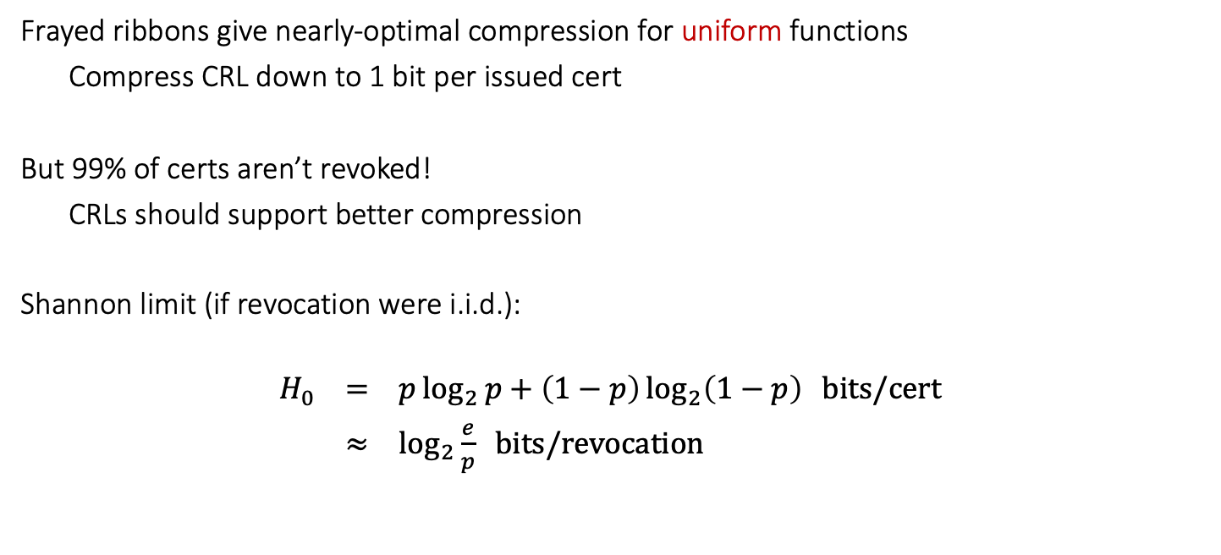
Why aren’t we done?
Frayed ribbons give nearly-optimal compression for uniform functions
Compress CRL down to 1 bit per issued cert
But 99% of certs aren’t revoked!
CRLs should support better compression
Shannon limit (if revocation were i.i.d.):
$$H_{0} = p\log_{2}{p}+\left(1−p\right)\log_{2}\left(1−p\right) bits/cert$$
$≈ \log_{2}{\frac{e}{p}} bits/revocation$

Slide 16
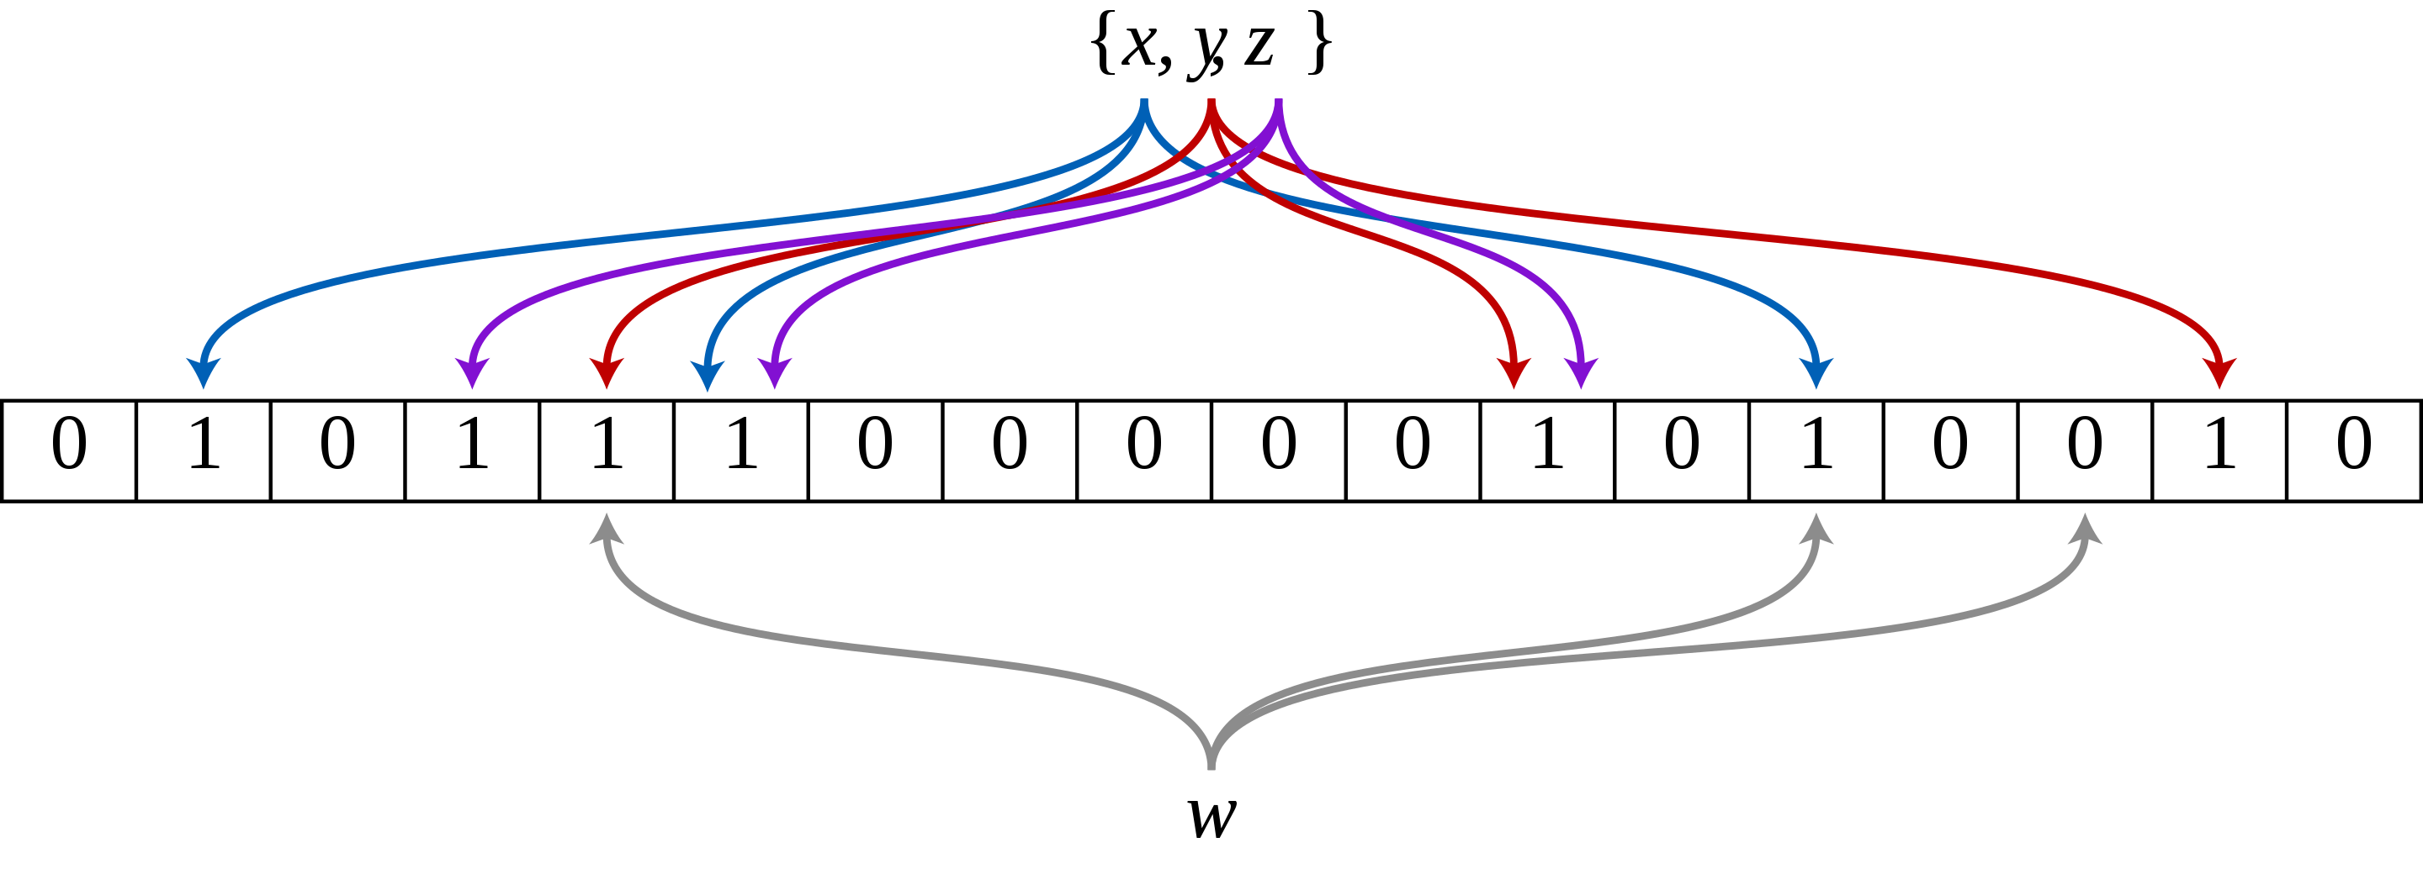
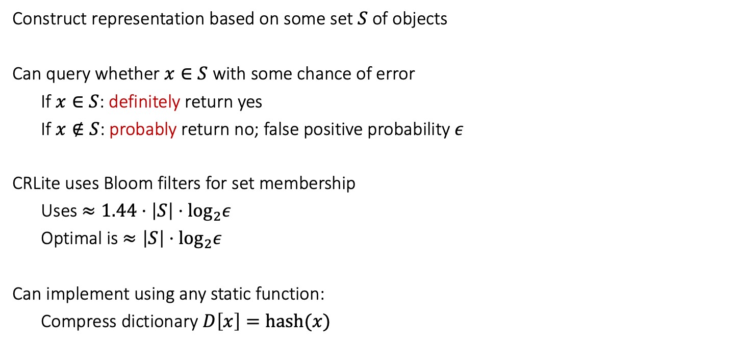
Approximate set membership
Construct representation based on some set $S$ of objects
Can query whether $x∈S$ with some chance of error
If $x∈S$: definitely return yes
If $x∉S$: probably return no; false positive probability $ε$
CRLite uses Bloom filters for set membership
Uses $≈1.44⋅\left|S\right|⋅\log_{2}ε$
Optimal is $≈\left|S\right|⋅\log_{2}ε$
Can implement using any static function:
Compress dictionary $D\left[x\right]=hash(x)$
Bloom filter diagram from Wikipedia by David Eppstein; public domain

Slide 17

CRLite: Bloom filter cascade
Level 1: set of revoked certs
On lookup:
No $→$ not revoked
Yes $→$ might be false positive
Level 2: set of false positives
On lookup if level 1 says yes:
No $→$ revoked
Yes $→$ might be false positive in L2 table
… uses $O\left(log n\right)$ levels
Level 1: revoked certs
L2: False positives in L1 table
L3: False positives in L2 table
L4
…

Slide 18
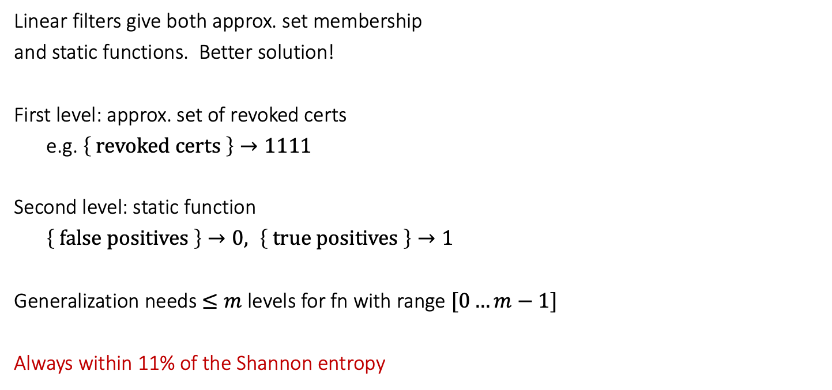
New work: two-level cascade
Linear filters give both approx. set membership
and static functions. Better solution!
First level: approx. set of revoked certs
e.g. $\left\{ revoked certs \right\}→1111$
Second level: static function
$\left\{ false positives \right\}→0, \left\{ true positives \right\}→1$
Generalization needs $≤m$ levels for fn with range $[0…m−1]$
Always within 11% of the Shannon entropy
Level 1: revoked certs
L2: False positives in L1 table
No need for L3

Slide 19
Prototype results

Slide 20

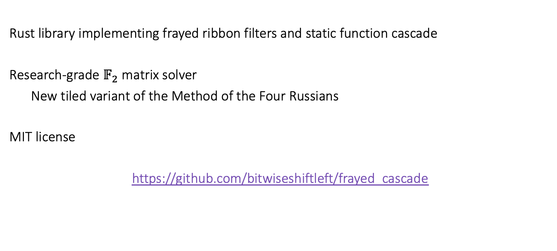
Prototype implementation
Rust library implementing frayed ribbon filters and static function cascade
Research-grade $𝔽_{2}$ matrix solver
New tiled variant of the Method of the Four Russians
MIT license
https://github.com/bitwiseshiftleft/frayed_cascade

Slide 21
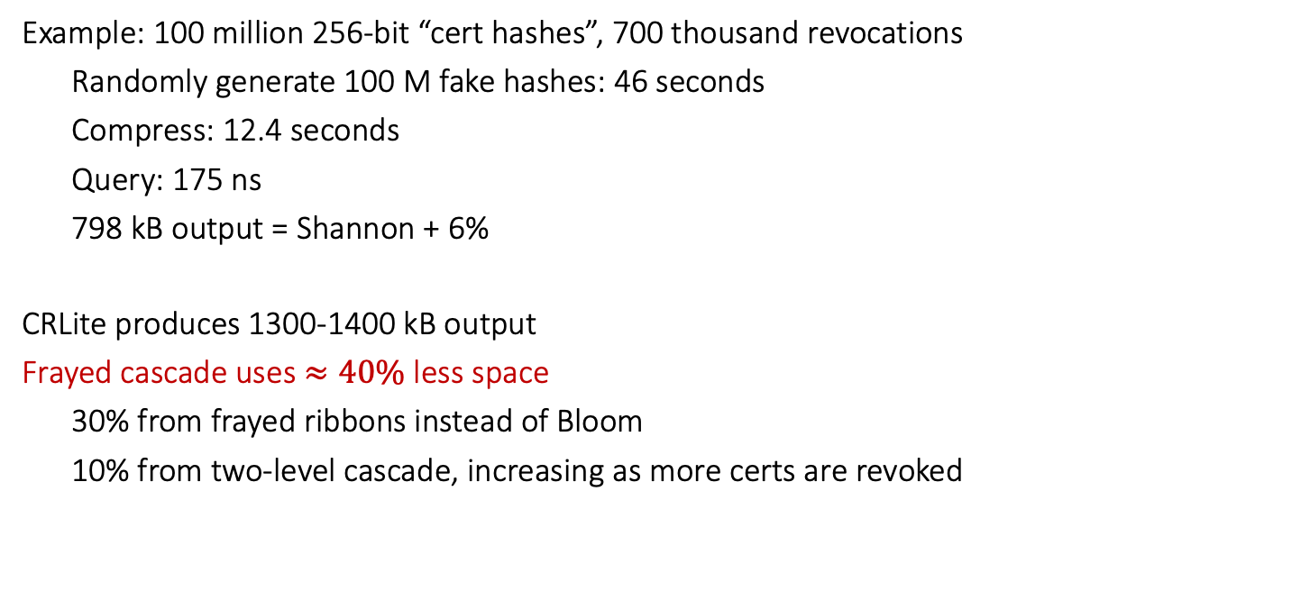
Comparison to CRLite
Example: 100 million 256-bit “cert hashes”, 700 thousand revocations
Randomly generate 100 M fake hashes: 46 seconds
Compress: 12.4 seconds
Query: 175 ns
798 kB output = Shannon + 6%
CRLite produces 1300-1400 kB output
Frayed cascade uses $≈40\%$ less space
30% from frayed ribbons instead of Bloom
10% from two-level cascade, increasing as more certs are revoked
Benchmark config: Rust version, SipHash13, StdRng
One core of a MacBook Pro 13”, 2.4 GHz Core i5-8279U, 16 GiB RAM

Slide 22
Future work

Slide 23
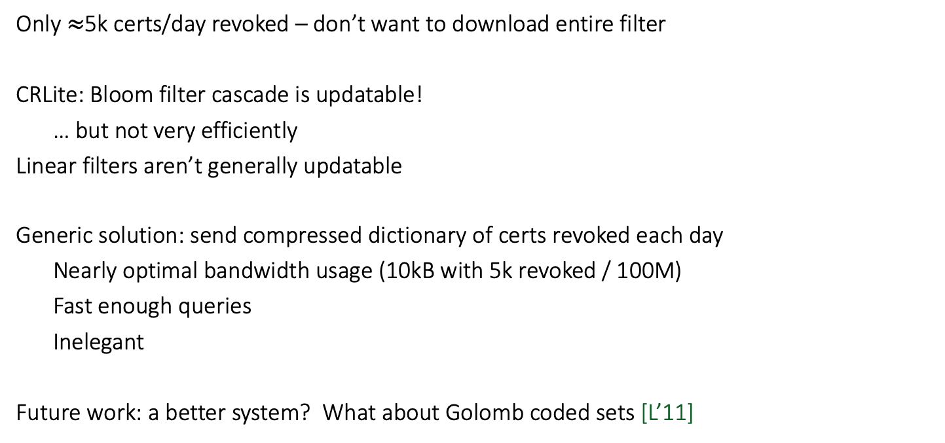
Incremental updates?
Only $≈$5k certs/day revoked – don’t want to download entire filter
CRLite: Bloom filter cascade is updatable!
… but not very efficiently
Linear filters aren’t generally updatable
Generic solution: send compressed dictionary of certs revoked each day
Nearly optimal bandwidth usage (10kB with 5k revoked / 100M)
Fast enough queries
Inelegant
Future work: a better system? What about Golomb coded sets [L’11]

Slide 24
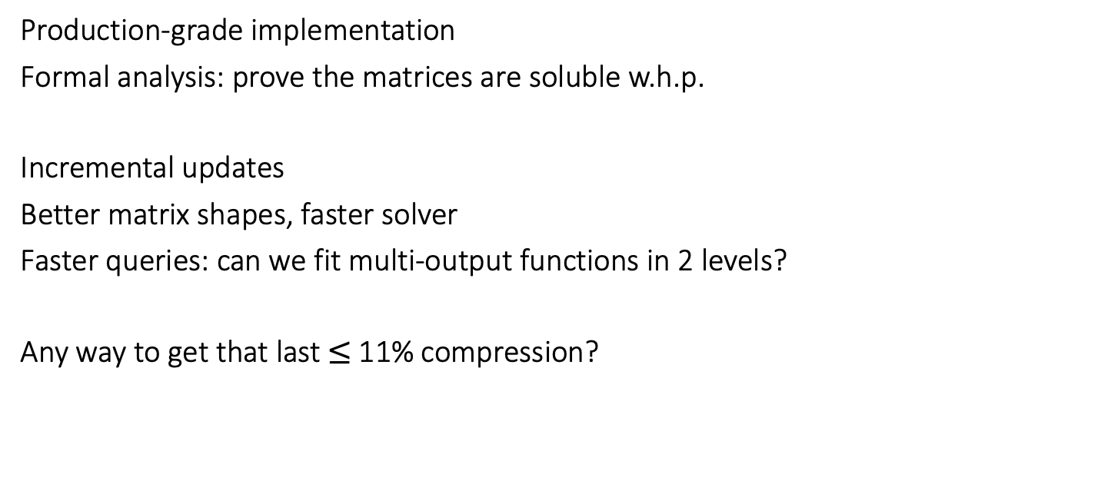
Future work ideas
Production-grade implementation
Formal analysis: prove the matrices are soluble w.h.p.
Incremental updates
Better matrix shapes, faster solver
Faster queries: can we fit multi-output functions in 2 levels?
Any way to get that last $≤$11% compression?

Slide 25
Conclusion
Static functions as pioneered by CRLite are a promising approach for distributing CRLs
Can also use for other info such as malware checks
New ”frayed ribbon cascade” approaches optimal efficiency for this use case
Fast queries, “fast enough” building
Future work may improve this even further

Slide 26
Questions?

Slide 27
References
[DP’08] Martin Dietzfelbinger and Rasmus Pagh. Succinct data structures for retrieval and approximate membership, 2008
[BBD’09] Djamal Belazzougui, Fabiano C Botelho, and Martin Dietzfelbinger. Hash, displace, and compress. In European Symposium on Algorithms, pages 682–693. Springer, 2009.
[L’11] Adam Langley. Smaller than Bloom filters. https://www.imperialviolet.org/2011/04/29/filters.html

Slide 28
References
[WRS’18] Sean A. Weaver, Hannah J. Roberts, and Michael J. Smith. XOR-satisfiability set membership filters. In Theory and Applications of Satisfiability Testing – SAT 2018, pages 401–418, Cham, 2018
[LCL+’17] James Larisch, David Choffnes, Dave Levin, Bruce M. Maggs, Alan Mislove, and Christo Wilson. CRLite: A scalable system for pushing all TLS revocations to all browsers. In 2017 IEEE Symposium on Security and Privacy, pages 539–556, 2017

Slide 29
References
[ML’18] Thomas Mueller Graf and Daniel Lemire. Fast Filter: Fast approximate membership filter implementations. https://github.com/FastFilter/fastfilter_cpp
[ML’20] Thomas Mueller and Daniel Lemire. Xor filters: Faster and smaller than bloom and cuckoo filters. ACM J. Exp. Algorithmics, 25, March 2020.
[DW’21] Dillinger and Walzer. Ribbon filter: practically smaller than Bloom and Xor. https://arxiv.org/abs/2103.02515, 2021
[ML’22] Thomas Mueller Graf and Daniel Lemire. Binary Fuse Filters: Fast and Smaller Than Xor Filters. Journal of Experimental Algorithmics 2022. https://arxiv.org/abs/2201.01174

