Slide 1
Code of Conduct on Safety and Security of Radioactive Sources & Guidance on Import and Export of Radioactive Sources
Dariusz Mroz & Christina George
INT9182 – Workshop on implementation of a national cradle to grave control system for radioactive sources
13-17 March 2017

Slide 2

Partnerships
INT9182 is conducted and implemented by the IAEA.
Funding is provided by:
European Union
Spain
United States
IAEA (through the TCF)
“The views expressed in this publication do not necessarily
reflect the views of the European Commission.”

Slide 3





Project Partners
Strategic, technical and financial partners:
European Commission
United States of America:
US NRC
US DOE/NNSA
Spain:
Consejo de Seguridad Nuclear
Canada:
Canadian Nuclear Safety Commission

Slide 4
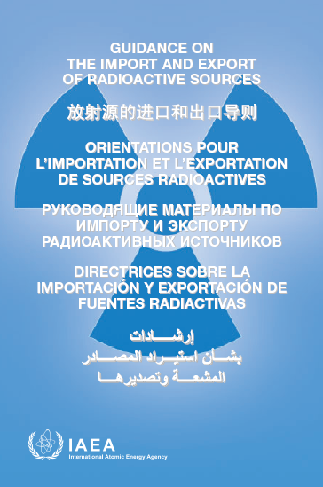
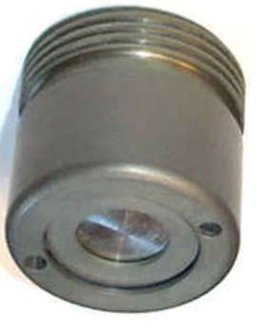
Code of Conduct and Import/Export Guidance

Slide 5
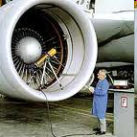
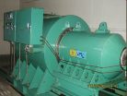

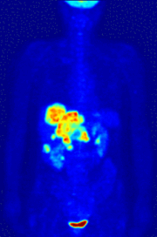
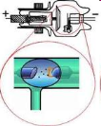
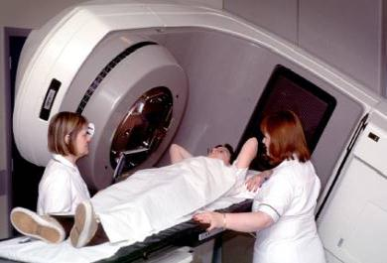





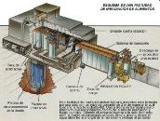

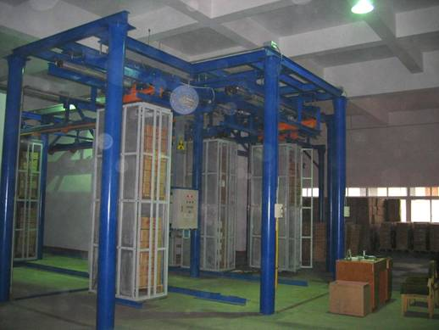















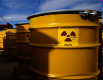



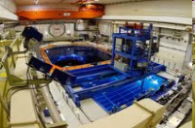


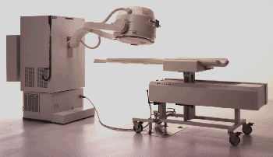

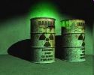
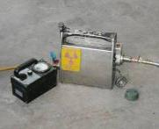
Radioactive Sources in Practice
Medicine
Agriculture
Industry
Research and Education
Border Control and Security

Slide 6
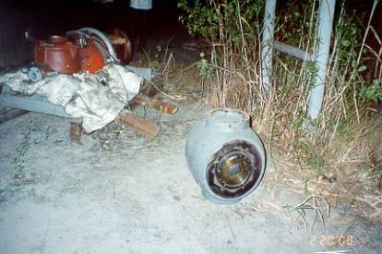
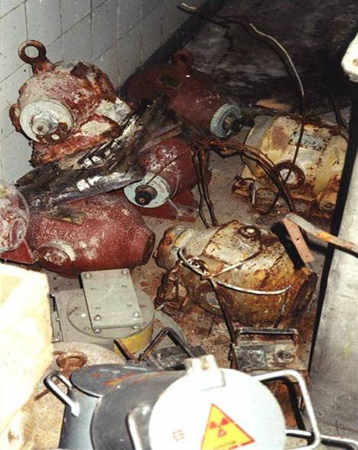
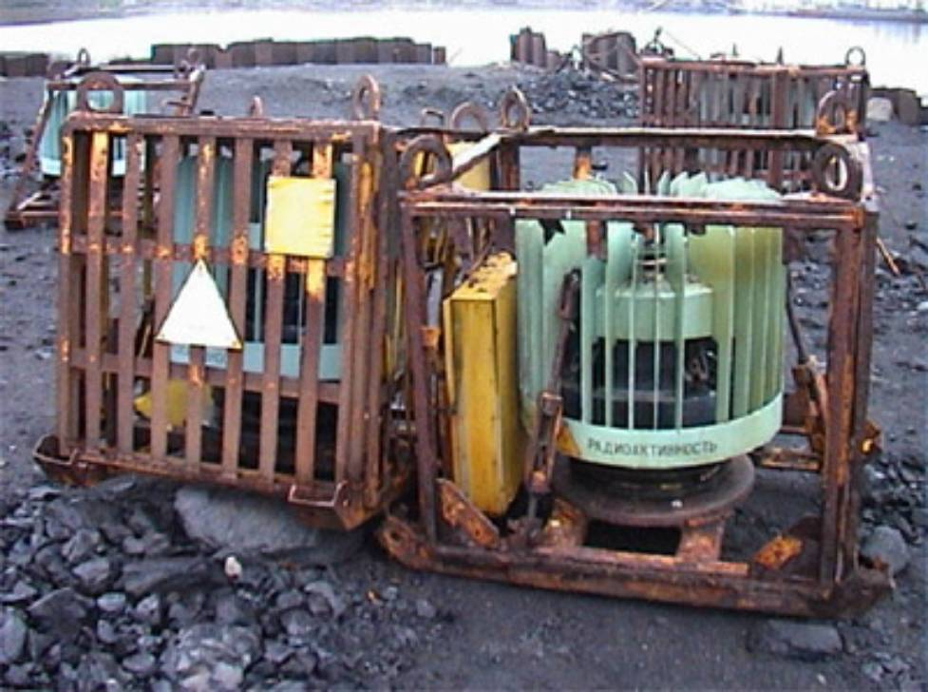
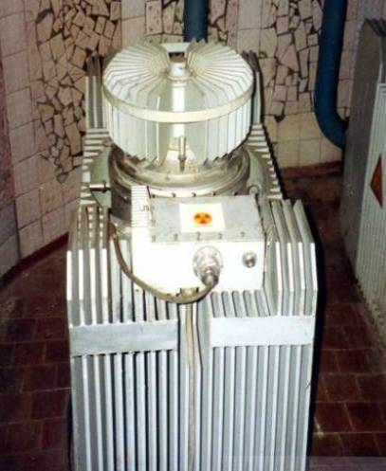
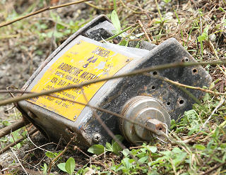
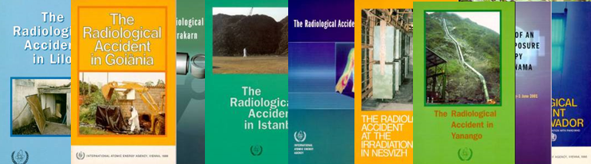
Disused sources can be orphan / vulnerable

Slide 7
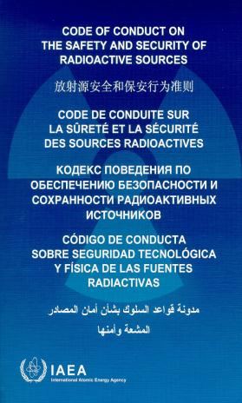

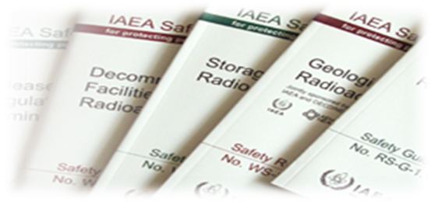
Objectives and Scope
1. to achieve and maintain a high level of safety and security
2. to prevent loss of control & malicious use
3. to mitigate or minimize the radiological consequences of any accident or malicious act
High risk sources: Category 1 to 3
Not applicable to:
nuclear material;
military programmes.
These objectives should be achieved through the establishment of an adequate system of regulatory control of radioactive sources

Slide 8
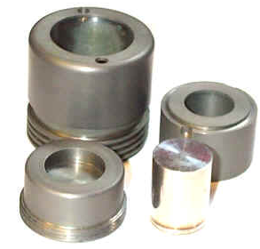
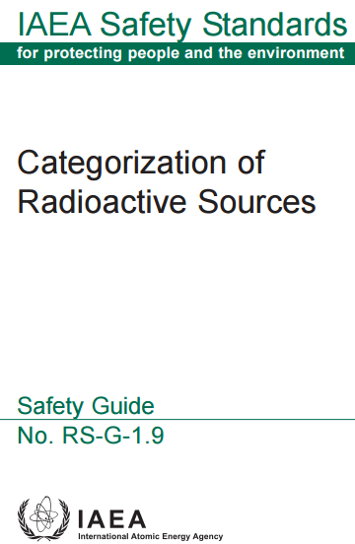
Categorization of radioactive sources
Extremely dangerous
Very dangerous
Dangerous
Unlikely to be dangerous
Most unlikely to be dangerous
* A = source activity; D = radionuclide-specific “dangerous” activity
Category | Practice examples | Ratio A/D *
1 | Irradiators; Teletherapy | A/D>1000
2 | Gamma radiography; HRD Brachytherapy | 1000>A/D>10
3 | High activity industrial gauges | 10>A/D>1
4 | Low activity gauges | 1>A/D>0.01
5 | Brachytherapy plaques | 0.01>A/D>Exempt/D
Increasing Risk

Slide 9


Every State should ensure:
Safe management, control and protection of sources
Safety culture promotion
Effective legislative and regulatory system
Primary responsibility for safety is on authorized parties
Strategies for regaining control over orphan sources
Minimized likelihood of loss of control
Rapid response for regaining control
Effective communications between the regulators and users

Slide 10
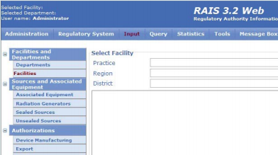
Every State should:
Establish a national register of radioactive sources
Ensure prompt information on loss of control
Promote awareness of the safety and security hazards
Encourage to implement appropriate monitoring
Encourage the reuse / recycling of radioactive sources
Emphasize responsibilities for safety and security
to designers, manufacturers, suppliers and users

Slide 11
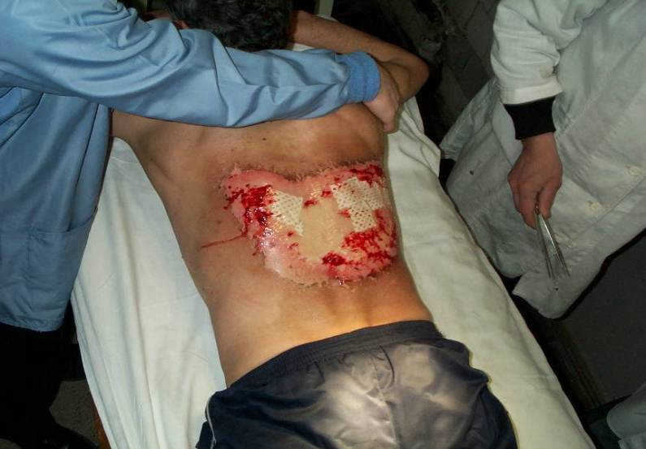
Legislation & regulations should:
Specify governmental responsibilities for safety and security
Provide for the effective control of sources
Specify the requirements for:
protection against exposure to radiation
safety and security of radioactive sources.

Slide 12
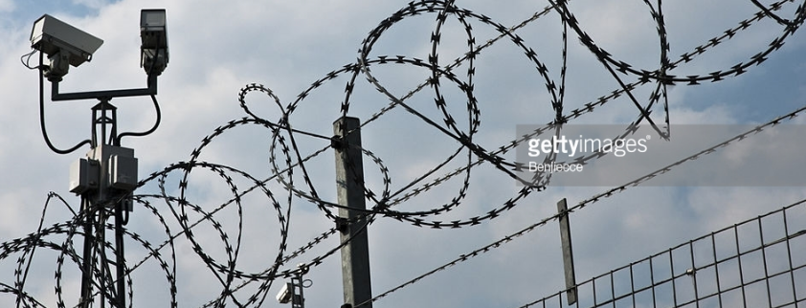
Legislation & regulations should provide for:
The establishment of an effectively independent regulatory body
Measures to protect individuals, society and the environment
Administrative requirements for notifications and authorization
Provisions for exemptions
Managerial requirements for policies, procedures and measures for the control of radioactive sources
Requirements for security measures
deter, detect and delay the unauthorized access
theft, loss, unauthorized use or removal
Requirements on the verification of the safety and security of sources
Capacity to take appropriate enforcement actions

Slide 13


Regulatory body should have the authority to:
Establish regulations and issue guidance on safety & security
Obtain all relevant information from applicants
Issue, amend, suspend or revoke authorization
Attach clear and unambiguous conditions to authorization
Obtain any necessary information from authorized persons
Require from suppliers technical information on safety
Enter premises to inspect for verification of compliance
Enforce regulatory requirements

Slide 14

Regulatory body should have the authority to:
Monitor for the purpose of detecting orphan sources
Ensure that corrective actions are taken
Provide to authorized bodies and the public proper information
Liaise and coordinate with other national bodies
Liaise with foreign regulatory bodies and international bodies
Establish criteria for intervention in emergency situations
Ensure that radioactive sources are stored in appropriate facilities

Slide 15

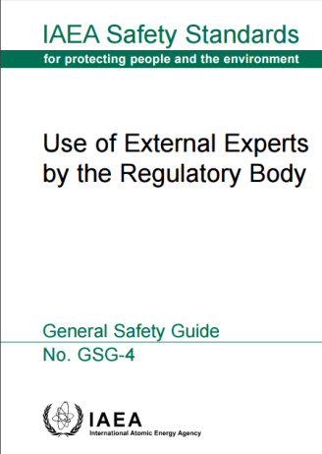
Every State should ensure that the regulatory body:
Is staffed by sufficient number of qualified personnel
Has the financial resources, facilities, and equipment
Has access to specialists and expertise
Establishes procedures for authorization
Ensures arrangements are made for the safe management and secure protection of radioactive sources
Financial provisions are made to manage disused sources
Maintains records of authorizations and radioactive sources

Slide 16
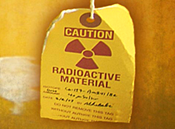

Every State should ensure that the regulatory body:
Promotes the safety and security culture
Ensures systems for proper marking of radioactive sources and their containers
Ensures systems for proper marking of areas where radioactive sources are managed
Establishes systems for ensuring that radioactive sources are identifiable and traceable
Ensures that inventory controls are conducted on a regular basis
Carries out inspections at an appropriate frequency
Takes enforcement actions to ensure compliance

Slide 17

Every State should ensure that the regulatory body:
Ensures that the regulatory principles and criteria remain valid
Requires the prompt reporting of loss of control and incidents in connection with radioactive sources
Provides guidance on appropriate information, and training to manufacturers, suppliers, and users of radioactive sources
Requires authorized persons to prepare emergency plans
Is prepared:
to recover and restore control over orphan sources
to deal with radiological emergencies
to assist in obtaining technical information relating to safe and secure management of sources of local origin

Slide 18
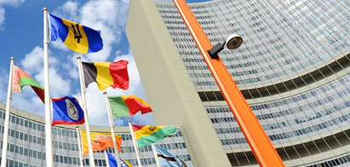
Role of the IAEA
To collect and disseminate information on laws, regulations and technical standards relating to the safety and security of radioactive sources
To develop and establish relevant technical standards and provide for the application of these standards
To disseminate the Code, the Guidance and related information
To implement the measures approved by its policy-making organs

Slide 19

Dissemination of the Code
Every State should inform persons involved in the management of radioactive sources of the measures taken to implement the Code
The following sectors should be considered:
industry,
health professionals,
government bodies,
the public

Slide 20
Code - Import and export of radioactive sources
Every State involved in the import or export of radioactive sources should take appropriate steps to ensure that transfers are undertaken in a manner consistent with the provisions of the Code
Transfers of sources in Categories 1 and 2 take place only with the prior notification by the exporting State and consent by the importing State in accordance with their respective laws and regulations.
Code Sections 23 - 29

Slide 21
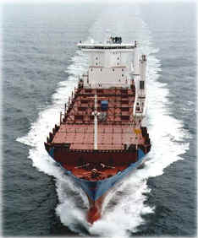
Guidance – Import and Export
Approved by the Board in 2004
Published originally in 2005
Revised in 2011
Published revised in 2012
Addresses paragraphs 23 – 29 of the Code on export-import

Slide 22
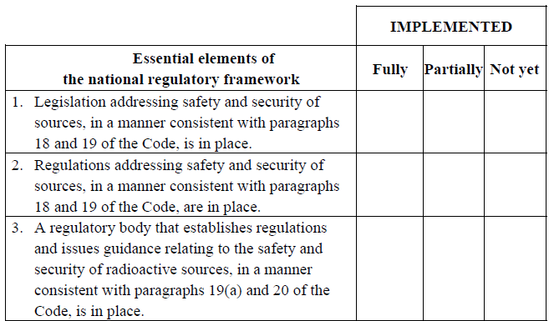

Import/Export Guidance contents
Provides guidance on how to import and export Category 1 and 2 sources in accordance with the Code of Conduct
Encourages nomination of a Point of Contact
Explains terminology on import and export of sources
Defines “exceptional circumstances”
Includes an “Importing and Exporting State Questionnaire”

Slide 23
Import and export of radioactive sources
Import of Category 1 and 2 sources should be authorized only if:
the recipient is authorized to receive and possess the source
the State has the appropriate technical and administrative capability, resources and regulatory infrastructure structure needed to ensure that the source is managed safely
Export of a Category 1 or 2 source should be authorized only if the exporting state can satisfy itself that the receiving State:
has authorized the recipient to receive and possess the source
has the appropriate technical and administrative capability, resources and regulatory infrastructure to ensure that the source will be managed safely

Slide 24
Exceptional circumstances
Import or export may also be authorized in exceptional circumstances
with the consent of the importing State
if an alternative arrangement has been made to ensure the source will be managed in a safe and secure manner.
Exceptional Circumstances
Cases of considerable health or medical need as acknowledged by importing and exporting State
Cases where there is imminent radiological hazard or security threat by radioactive source(s)
Cases in which the exporting facility or State maintains control of radioactive source(s) throughout the period they are outside the exporting State

Slide 25
Import and export of radioactive sources
Every State should allow for re-entry of disused radioactive sources if, in the framework of its national law, it has accepted that they be returned to a manufacturer authorized to manage the disused sources.
Every State should take steps to ensure that import or export is conducted in a manner consistent with relevant international standards for the transport of radioactive materials.
Transport of radioactive sources through the territory of a transit or trans-shipment state:
should be conducted in a manner consistent with existing relevant international standards relating to the transport of radioactive materials
particular attention should be paid to maintaining continuity of control during international transport.

Slide 26
Evaluation of request
In deciding whether to authorize the export of Category 1 source, the exporting State should:
satisfy itself that the recipient is authorized to possess the source
satisfy itself that the importing State has technical and administrative capability, resources and regulatory structure needed for the management of the source
consider:
whether the recipient has been engaged in illegal procurement of radioactive sources
whether import or export has been denied to the recipient or importing State
the risk of malicious acts involving radioactive sources

Slide 27
Notification prior to shipment
The importing State is notified in advance of each shipment with the following information:
the estimated date of export
exporting facility
recipient
radionuclides and radioactivity
aggregate activity level
the number of radioactive sources and their unique identifiers
Notification may originate from the exporting State or exporting facility. A copy should be provided to the exporting State’s regulatory body
Notification should be accompanied by a copy of the consent
Notification should take place at least 7 days in advance of shipment
The export of the source shall be conducted according to international transport regulations.

Slide 28
Export authorization of Category 2 sources
Same procedures as for Category 1 sources, except:
Consent from the importing State is not required prior to export authorization.
Instead of exporting State, the exporting facility may check the recipient authorization.
Notification prior to shipment of Category 2 sources
Same procedures as for Category 1 sources
(copy of consent is not required)

Slide 29
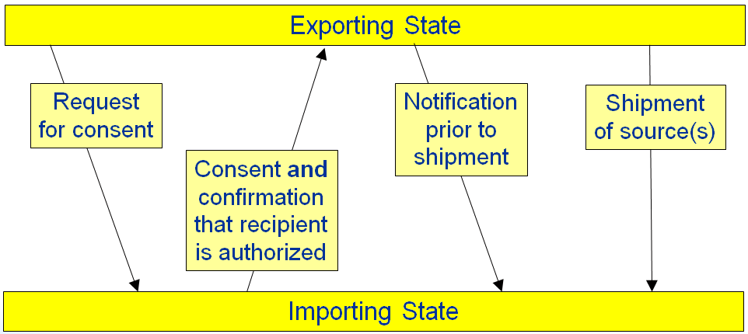
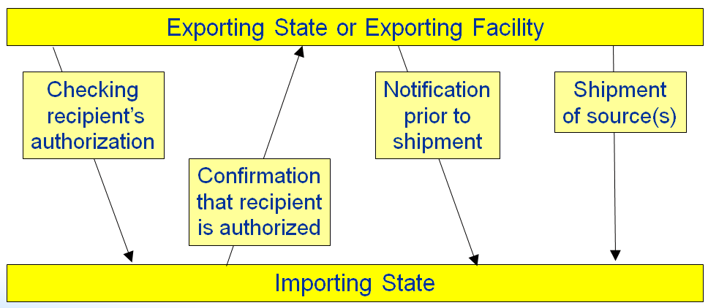
Scheme of export of Category 1 sources
Scheme of export of Category 2 sources

Slide 30
Import authorization of Category 1 and 2 sources
The importing State should:
satisfy itself that the recipient is authorized to possess the source
satisfy itself that it has technical and administrative capability, resources and regulatory structure needed for the management of the source
consider:
whether the recipient has been engaged in illegal procurement of radioactive sources
whether import or export has been denied to the recipient
the risk of malicious acts involving radioactive sources
If the importing State decides to import it should ensure:
Exporting State obtained the confirmation that the recipient is authorized (or copy of the recipient authorization)
Exporting State obtained the copy of consent (Category 1 source)
Transport is conducted according to international standards

Slide 31
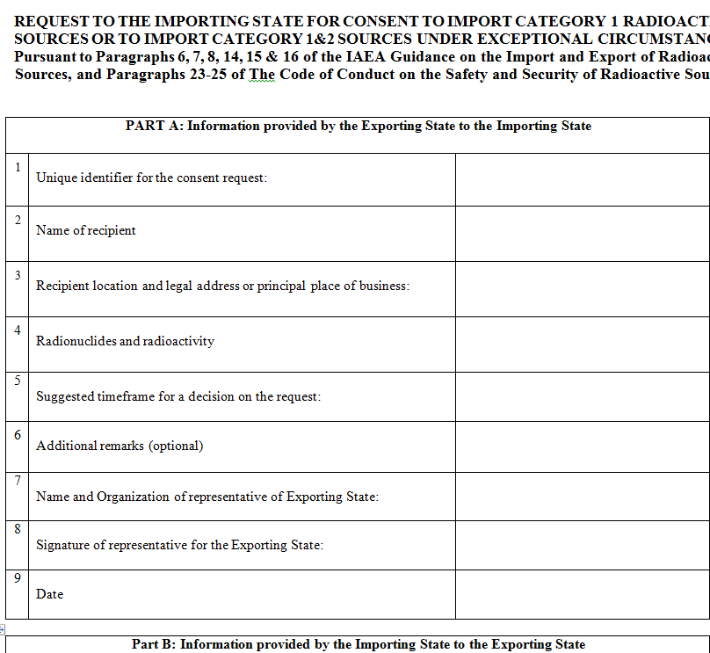
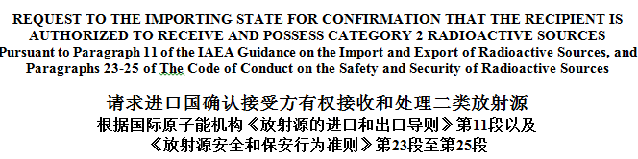
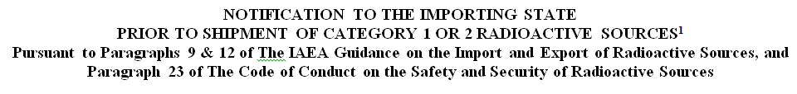
Implementation of the Code and Guidance - forms
Request to the importing state for consent to import Category 1 radioactive sources or to import Category 1 and 2 sources under exceptional circumstances
Request to the importing State for confirmation that the recipient is authorized to receive and possess Category 2 radioactive sources
Notification to the importing state prior to shipment of Category 1 or 2 radioactive sources

Slide 32
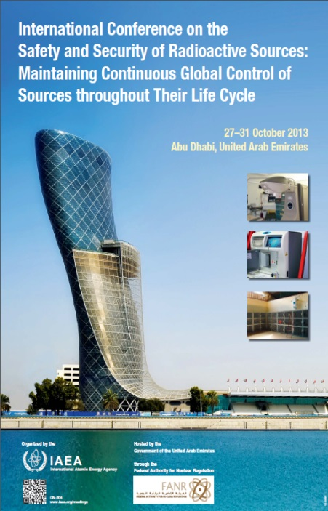
Implementation of the Code - meetings
2007 : 1st Meeting based on formalized process held to share information as to States’ Implementation of the Code of Conduct on the Safety and Security of Radioactive Sources and its supplementary Guidance on the Import and Export of Radioactive Sources – 122 experts from 72 States
2010 : 2nd Meeting based on formalized process held to share information as to States’ Implementation of the Code of Conduct on the Safety and Security of Radioactive Sources and its supplementary Guidance on the Import and Export of Radioactive Sources – 160 experts from 91 States
2013 : 3rd Meeting – International Conference, Abu Dhabi
The first international conference on safety and security of radioactive sources since Bordeaux (2005)

Slide 33
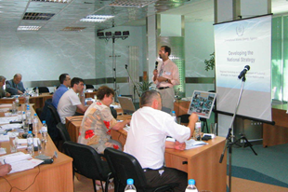
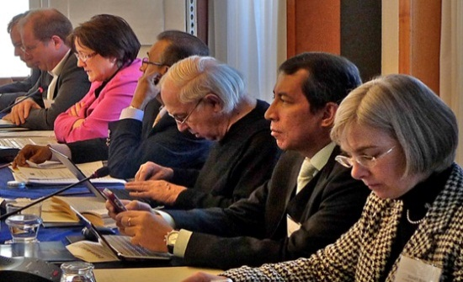
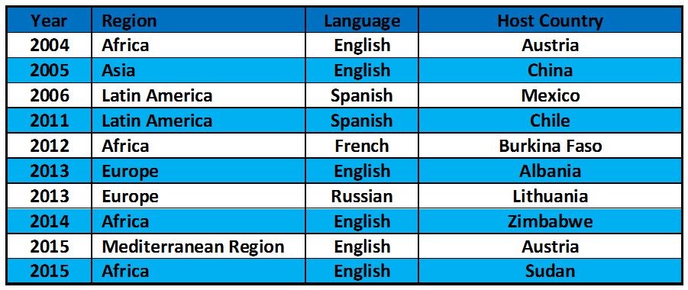
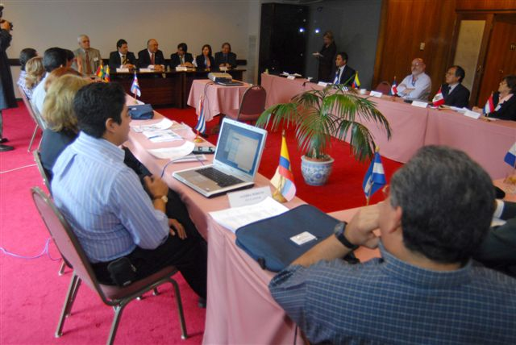
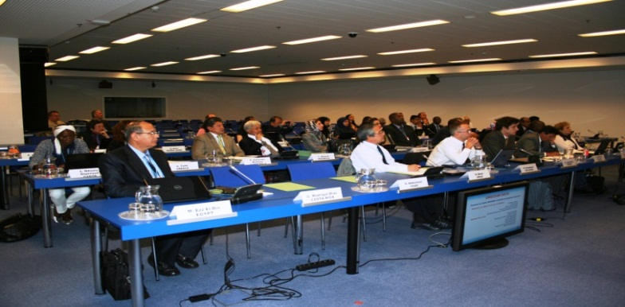
Implementation of the Code - workshops

Slide 34
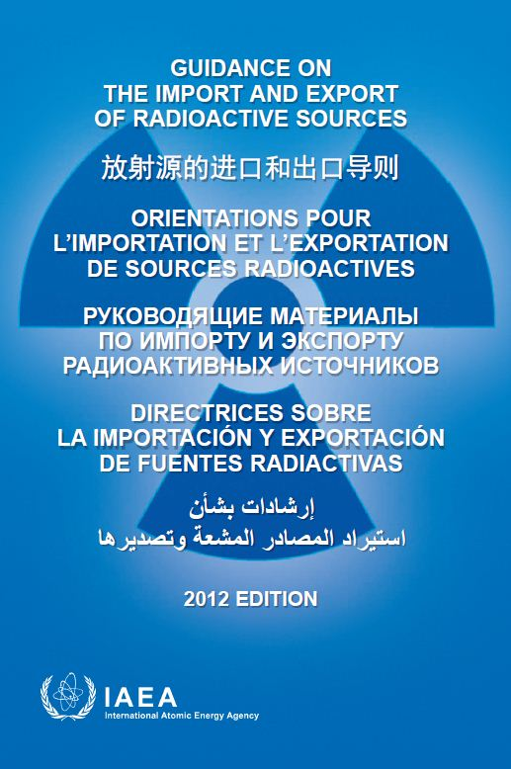
State of political commitment world-wide

Slide 35
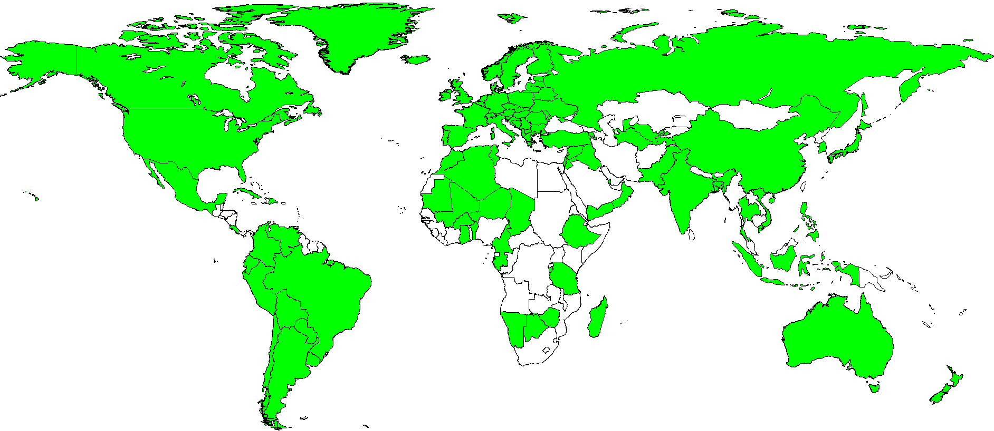


International support status

Slide 36
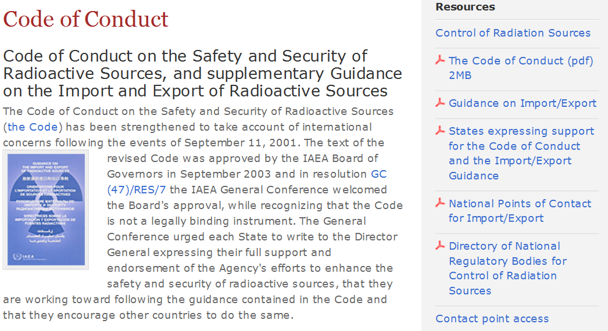
Information source on Code and Guidance
https://www-ns.iaea.org/tech-areas/radiation-safety/code-of-conduct.asp?s=3&l=22

Slide 37
Conclusions
Radioactive sources shall be safely managed during their entire life cycle (cradle-to-grave control)
States shall promote safety and security culture for management of radioactive sources
An effective sustainable national legislative and regulatory framework shall be established
Assessment of source vulnerability shall be based on loss of control or malicious act scenarios
The Code of Conduct and its Supplementary Guidance are essential means to assure safe management of radioactive sources globally throughout their life-cycle

Slide 38
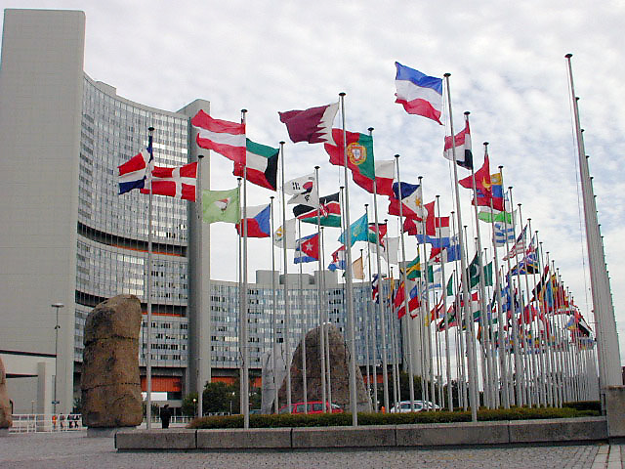
Thank you!
Notes:
Thank you!

