Slide 1
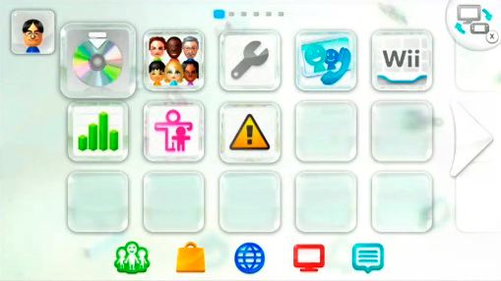
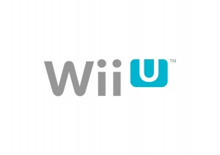
The Wii U OS
By: Zachary Behnke

Slide 2
When the OS Launched
When the OS launched back in November 2012, it was painfully slow.
It sometimes took 30-45 seconds to load up an application, and that was even if you were just on the menu screen.

Slide 3
Design
The Wii U OS is a GUI, based on the Wii’s OS and takes some cues from the 3DS OS as well.
Each application has a channel associated with it. These can be moved and placed anywhere on the screen, with the buttons, or touch controls.

Slide 4
Updates Galore
When the console launched, it had a mandatory update to version 2.0.0, which took upwards of 1 hour to install. This enabled a ton of needed features for the Wii U, but it came at the cost of not being able to play your new system right when you open it.

Slide 5
Asymmetric Gameplay
One of the main features of the Wii U OS is the Asymmetric features.
This is where you have two different displays, one on the controller and one on the TV.

Slide 6
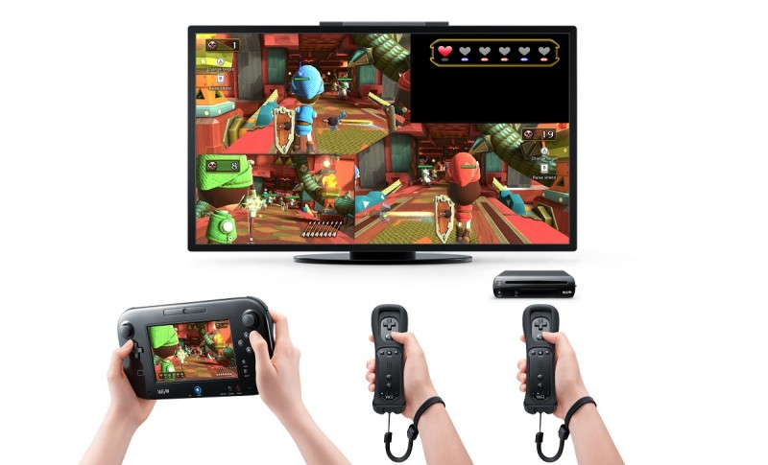
Example of Asymmetric Gameplay

Slide 7
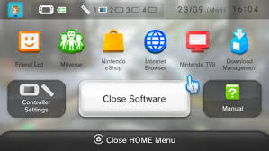
HOME Menu
The HOME menu of the Wii U OS is where have an application suspended, and go to the Internet, check Miiverse, or even chat with friends.

Slide 8
How is that done, you may ask?
Well, the Wii U has 2 GB of RAM associated with it, and one whole gig is based solely for the OS. This makes things like the HOME menu possible, without much overhead time.
Context switching is handled very well, with low wait time between processes (at least now it’s low)

Slide 9
I/O Devices
The Wii U OS can accept a few different forms of I/O.
Forms it can accept:
  SD Card (Up to 32 GB)
  External Hard-Drive (Up to 2 TB)
  Flash Memory (Either 8 GB or 32 GB)

Slide 10
Connectivity
The OS of the Wii U is able to wirelessly connect to WiFi, which enables it to do things like:
  Go to Miiverse
  Browse the Nintendo eShop
  Go to the Internet Browser
  It also has a really neat auto-download feature, which downloads games/updates even if the system is turned off.

Slide 11
What the OS Runs on
The OS runs on IOS-code, which is short for Internal Operating System.
Runs on separate CPU, called “Input/Output” processor.
Does not take resources from the main CPU, so the game can have 100% of the RAM. While a game is running, the OS is put in a standby mode.

Slide 12
Microprocessor
Called the Espresso.
  Based on Broadway, the microprocessor used in the Wii.
  32-bit
  Clock rate is 1.24 GHz
  3 cores
  CPU and graphics processor placed on a single substrate
  Performs out-of-order processing.

Slide 13
Benefits of Espresso
Some benefits of Espresso are:
  Reduces memory latency
  Reduce power consumption
  Reduce space and cost
  Reduce complexity
  Increase communication between the two chips

Slide 14
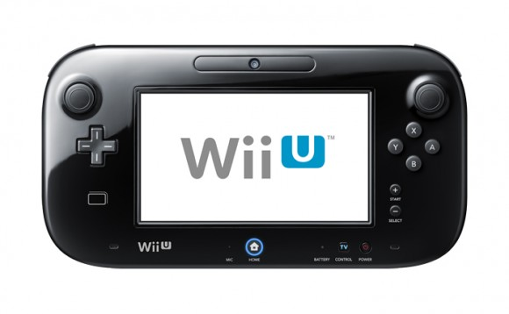
The Wii U Gamepad
The Wii U Gamepad works concurrently with the console for a variety of different features.
Display is handled by sending smaller, compressed images of the GPU of the console to the gamepad screen.
Built up in packets of data, and then sent to the Gamepad.

Slide 15
Miiverse
Miiverse is Nintendo’s social network, that is tied into the OS.
Features:
  Games have communities, where you can yeah posts, and comment on them.
  Very useful when you get stuck in a game.
  Can post text, pictures from your games, and artwork.

Slide 16
Current Version of the OS
The current version of Wii U OS is 4.1.0, which only improved system stability and performance.
4.0.0., however, improved a lot features, most notably, being able to display Wii games on the gamepad screen. They still have to be controlled with a Wii Remote, or accessory, however.

Slide 17
Management of Resources
The OS manages resources fairly well, with low overhead time between the switching of processes, and no overhead time to suspend a process.
The OS also can run processes in parallel, allowing you to access the Internet and Miiverse, while a game is running in the background.

Slide 18
Show Wii U to Class

