Slide 1
Happier Abroad Presentation on International Dating
Winston Wu and Steve Neese
www.HappierAbroad.com

Slide 2
“All truth passes through three stages. First, it is ridiculed. Second, it is violently opposed. Third, it is accepted as being self-evident."
“Every man takes the limits of his own field of vision for the limits of the world.”
- Arthur Schopenhauer

Slide 3
“It takes far less effort to find and move to the society that has what you want than it does to try to reconstruct an existing society to match your standards.”
- Harry Browne, How I Found Freedom in an Unfree World
“If the society in the US says that the problem is *you*, then try changing societies. You may be in for a big surprise.”
- Ladislav, Chief Advisor of HappierAbroad.com

Slide 4
Key Points of the Happier Abroad Movement
Presented by Winston Wu

Slide 5
Outline of points to cover
Comparisons of Social Culture, Dating and Mental Health in America vs. many Foreign countries.
Why International Dating and Foreign Women? Key Benefits and Advantages.
Approachable faces of foreign females – Visual proof of a refreshing difference in attitude.
Research and statistics along with experts, prove that international relationships have a higher success rate than domestic relationships.

Slide 6
Three Point Comparison
America in general
Many Foreign countries
Lifestyle and environment devoid of human connection.
Dating and relationships are a no-win nightmare for many men.
The socio-cultural environment makes one insecure and inauthentic. (1/3 have seen a shrink)
Human connection and social interaction flow more freely and naturally.
Dating and relationships are more natural and complementary.
One feels more accepted, whole and authentic. (Seeing a shrink is unheard of)

Slide 7
America in General
1. Social Culture
Social disconnectedness, no human connection
Socially isolated, cliquish, non-inclusive
2. Dating and Relationships
Women taught to despise men and hate femininity
Women are super picky and reject most men (or all)
3. Mental and Psychological Health
One feels insecure and not accepted for themselves
Highest rates of mental illness in the world (at least 1/3 have seen a shrink)

Slide 8
Foreign Countries in General
1. Social Culture
Social environment is more inclusive and open
People are more authentic, natural, down-to-earth
2. Dating and Relationships
Women are feminine, sweet, modest, down-to-earth
Women admire, respect and appreciate men
3. Mental and Psychological Health
One feels accepted and free to “be yourself”
No need to act fake or pump yourself with pseudo-confidence (Seeing a shrink is literally unheard of)

Slide 9
Implications and Solutions (1 of 3)
It is important to note that global problems such as crime, corruption, economic oppression, and the desire to up one’s status, are NORMAL and have existed throughout human history.
However, the modern dysfunctional norms in America, such as: women despising men, not needing them, hating their femininity and trying to be masculine; social disconnectedness, neighbors not knowing each other, lack of human connection, not being accepted, etc. are ABNORMAL aberrations that have NEVER been part of human history.

Slide 10
Implications and Solutions (2 of 3)
Therefore, one cannot help but wonder if something dark and sinister is going in regard to the social engineering of America. It certainly seems like it.
While one cannot change his society or culture, one can take sovereignty over his life by making smart choices to find compatible partners, places and cultures for the best chances of success in love, life and happiness.
The most important first step is to STOP living in fear and worrying about what others think. You must LIBERATE your mind from this conditioning first.

Slide 11
Implications and Solutions (3 of 3)
An important lesson that you are never taught in Western culture, is that true confidence comes from being accepted and appreciated for who you are. (which people have in most foreign countries) What is hyped as “confidence” in America (especially on the West Coast) is fake artificial “pseudo-confidence” that must be constantly pumped and inflated, resulting in unnatural and inauthentic personalities.
In the next section, we will present GOOD NEWS for single males in North America about the Foreign Women SOLUTION and what it offers them.

Slide 12
Key Benefits and Advantages of Foreign Women
Good News for Single Men
in North America

Slide 13
Benefits and Advantages of
Foreign Women (1 of 2) View Full Version
They are very feminine and proud of it.
They generally treat men better.
They are more down-to-earth, natural and authentic in attitude and personality.
They liberate men from insecurity.
They are usually thin, not overweight.
Women in FSU, E. Europe, Latin America and China are approachable, friendly and easy to meet.
They are raised with good family values.
They appreciate and reciprocate niceness.

Slide 14
Benefits and Advantages of
Foreign Women (2 of 2) View Full Version
Women from non-Westernized countries are marriage-minded with traditional values.
Women from FSU, SE Asia and Latin America are more tolerant of age differences in their partner.
They are more mature at an earlier age.
They still believe in old fashioned romance.
Beauty and brains are the norm (not the exception) in women from FSU, Europe and China.
Women from SE Asia and Latin America are very tolerant, easy going and nonjudgmental.

Slide 15
Approachable Faces Gallery
Visual Proof that Foreign females are NOT instilled with a “men are creeps” attitude. See the looks of openness, admiration and curiosity on the faces of foreign girls I met overseas that show a refreshing attitude. “A picture is worth a thousand words.”

Slide 16
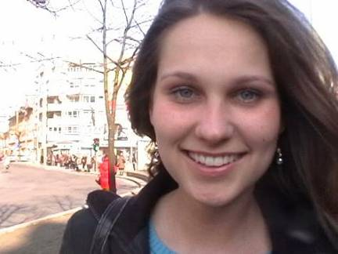
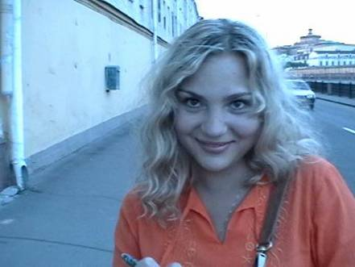
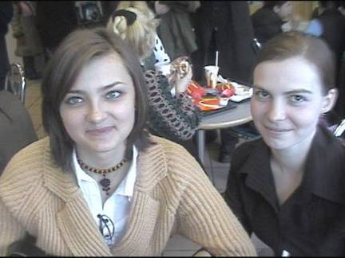
Approachable Faces from
Russia and Eastern Europe

Slide 17
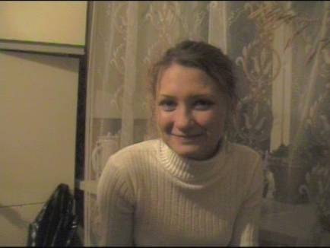
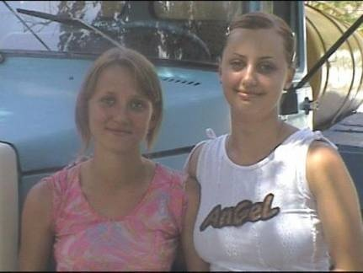
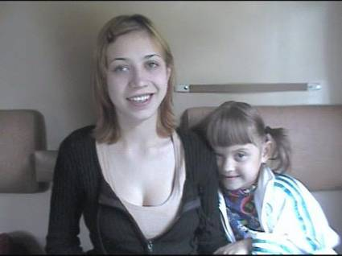
Approachable Faces from
Russia and Eastern Europe

Slide 18
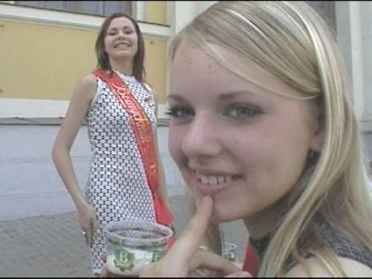
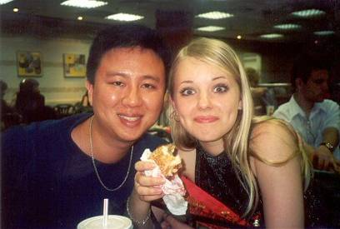
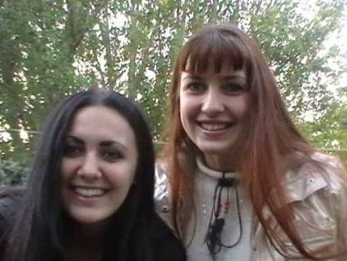
Approachable Faces from
Russia and Eastern Europe

Slide 19
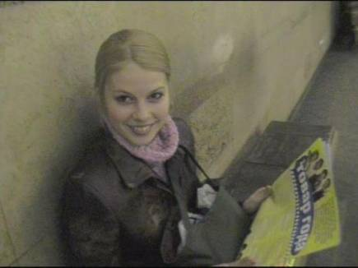
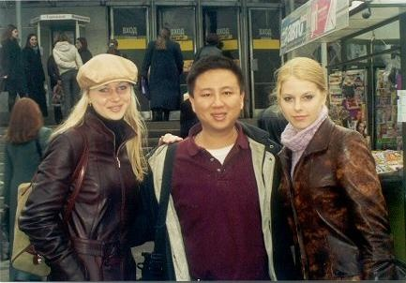
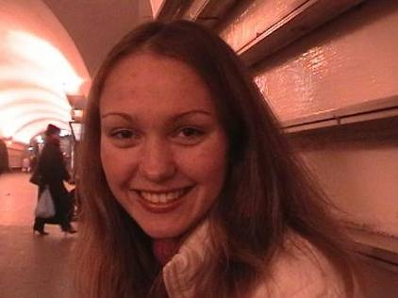
Approachable Faces from
Russia and Eastern Europe

Slide 20

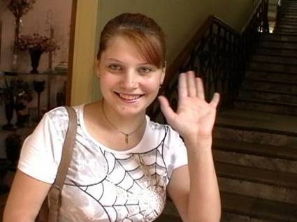

Approachable Faces from
Russia and Eastern Europe

Slide 21
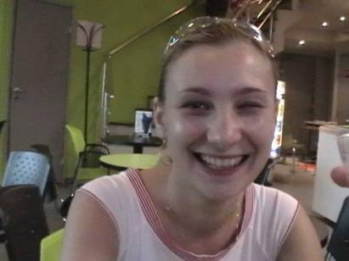


Approachable Faces from
Russia and Eastern Europe

Slide 22
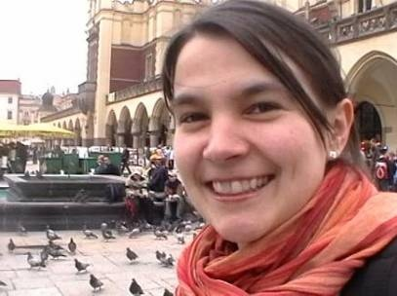
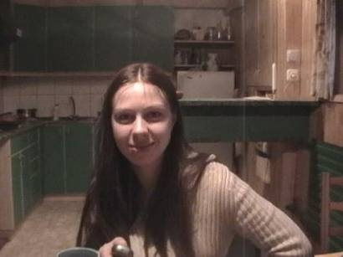

Approachable Faces from
Russia and Eastern Europe

Slide 23
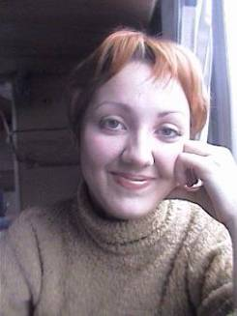
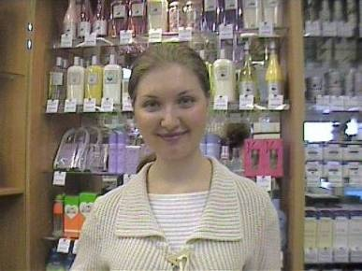
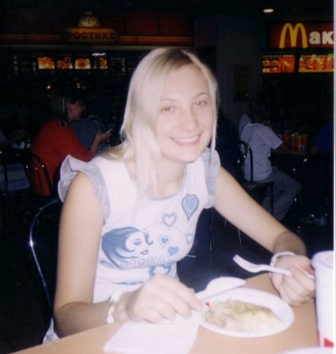
Approachable Faces from
Russia and Eastern Europe

Slide 24
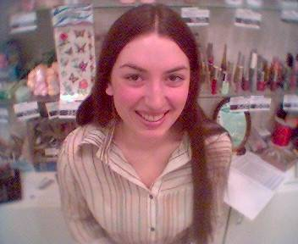
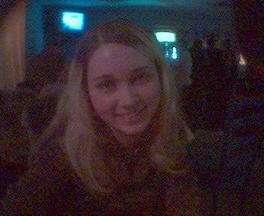
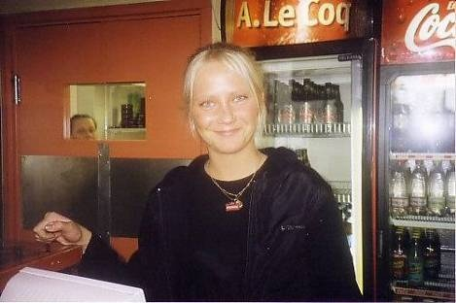
Approachable Faces from
Russia and Eastern Europe

Slide 25
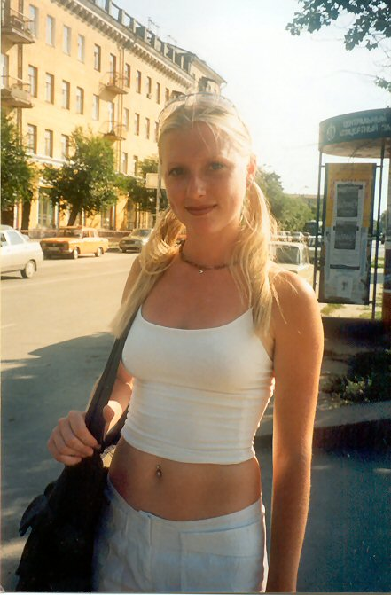
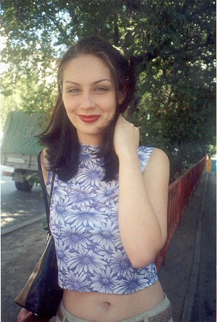
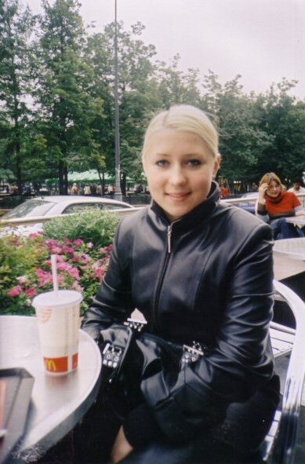
Approachable Faces from
Russia and Eastern Europe

Slide 26

Video clip of friendly Moscow girl I approached.
Click below to play clip
See more clips in the video section of HappierAbroad.com

Slide 27
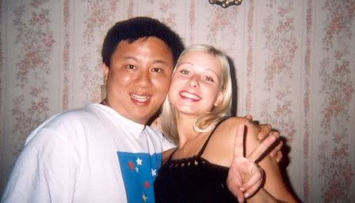
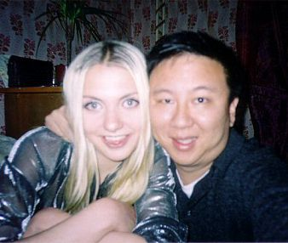
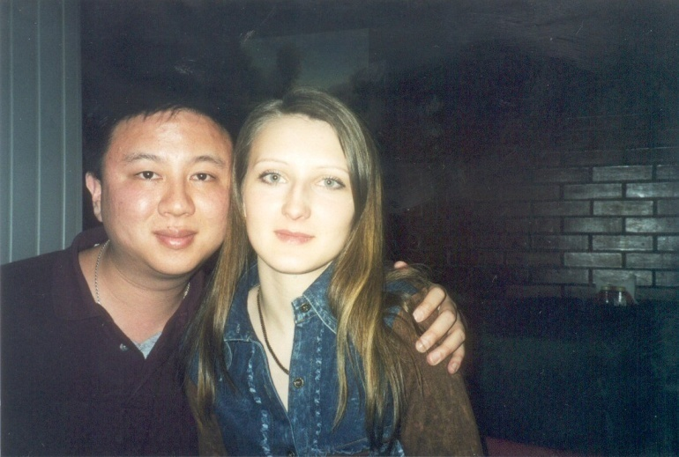
Friendly girls I met in Russia and Eastern Europe (1 of 3)

Slide 28
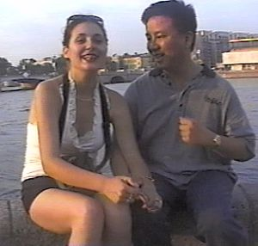
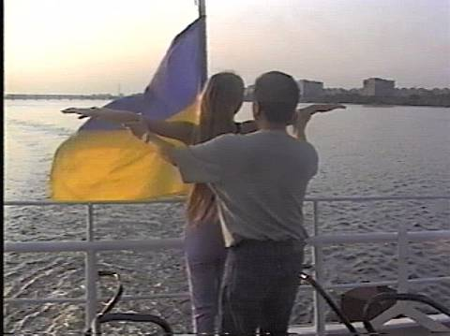
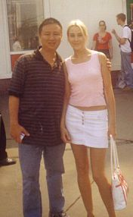
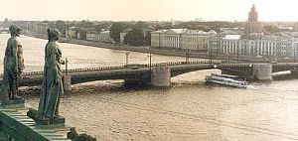

Friendly girls I met in Russia and Eastern Europe (2 of 3)

Slide 29
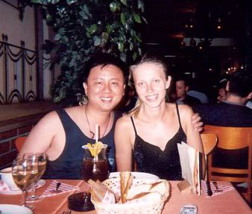
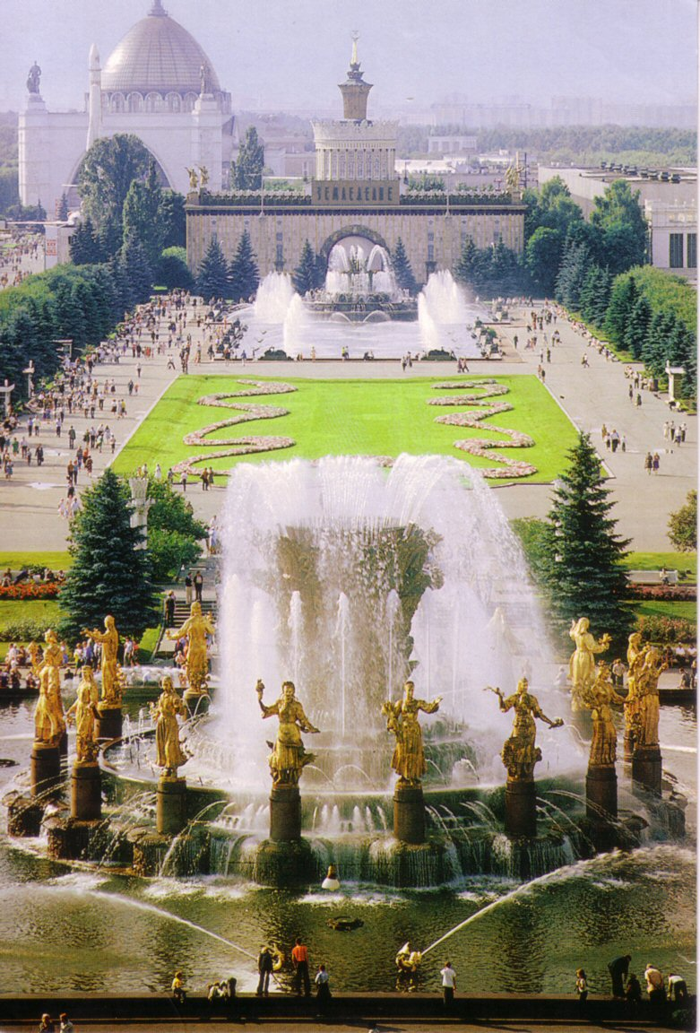
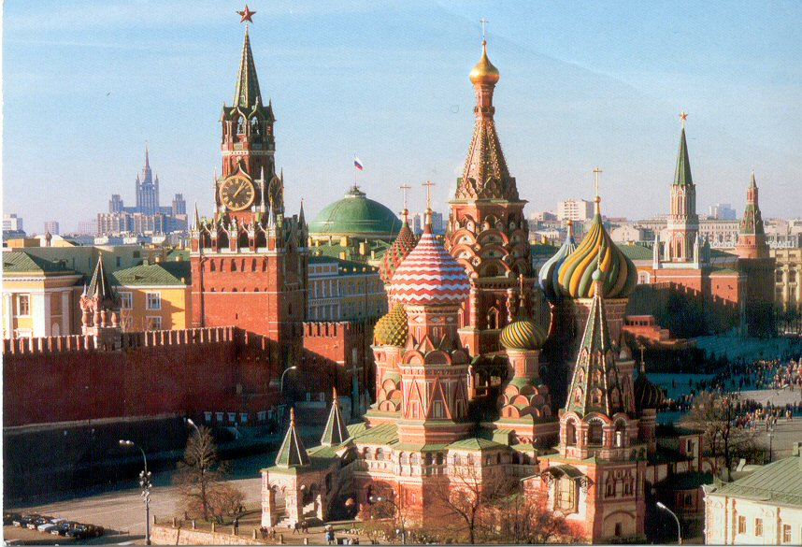
Friendly girls I met in Russia and Eastern Europe (3 of 3)

Slide 30
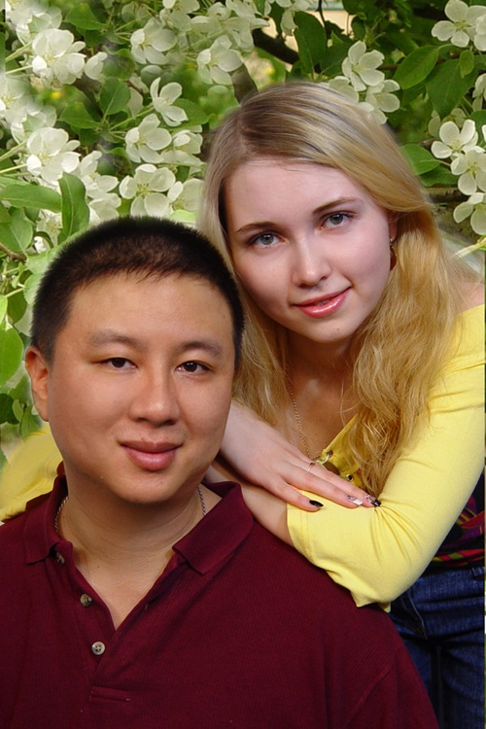
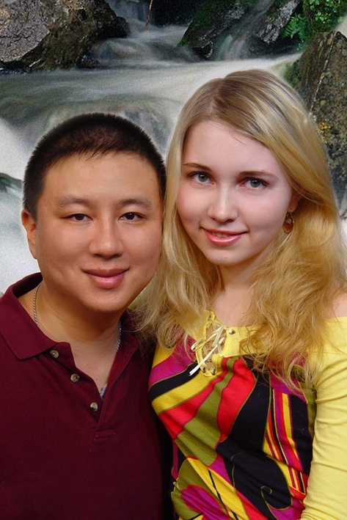
Marina, a sweet girl I dated in Russia

Slide 31
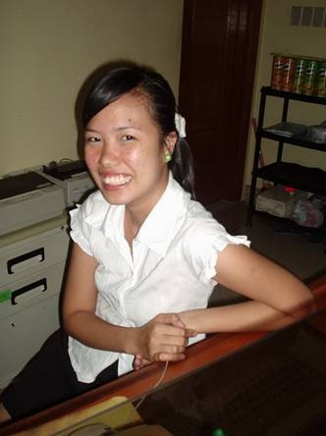
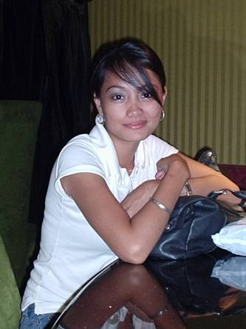

Approachable Faces from Philippines

Slide 32
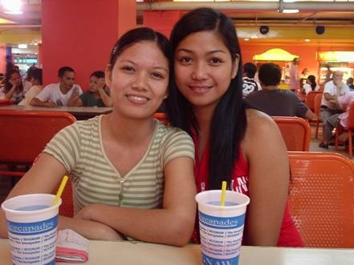
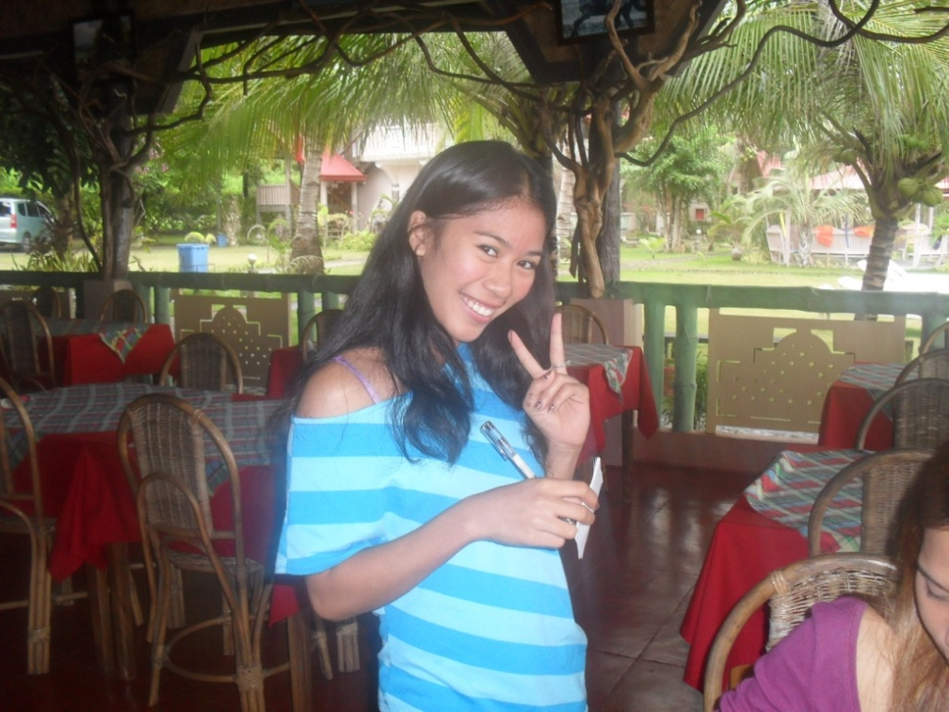
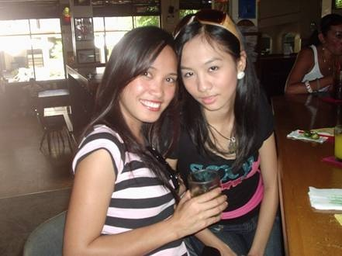
Approachable Faces from Philippines

Slide 33
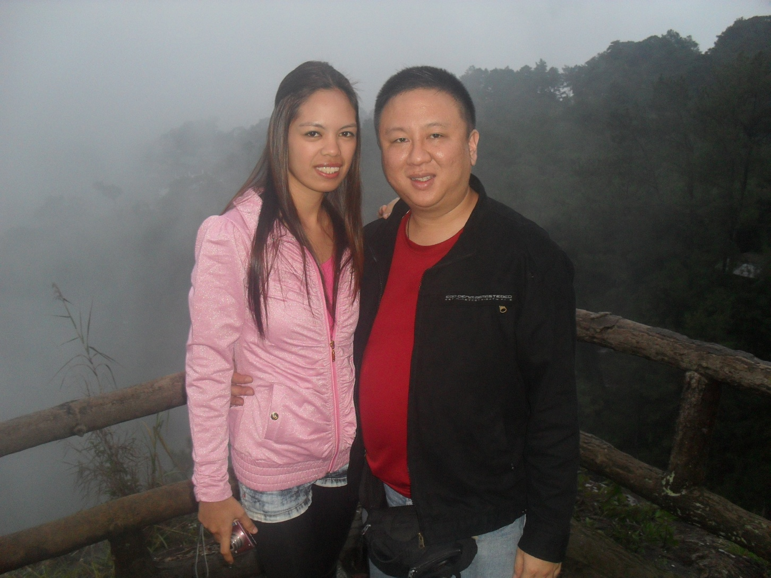
Dianne, a girl I dated in the Philippines

Slide 34
No PUA or “Game” Required
As you can see, when females are sweet, friendly and down to earth, no fake artificial “PUA or game” is required to meet them. You can just be yourself.
That’s the beauty and simplicity of it. It’s totally natural and normal – the way it was meant to be.
Deep down, we all want to be accepted for who we are. But we don’t get that acceptance in America.
This is liberating to American men because it frees them from constant insecurity in regard to women.

Slide 35


Beautiful Chinese woman I met on AFA – Feminine, Down-to-Earth, Intelligent
Click images to browse Foreign women profiles

Slide 36
International Dating vs. Domestic Dating:
Research and Statistics
Presented by Steve Neese

Slide 37
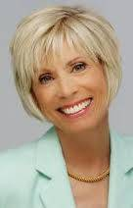
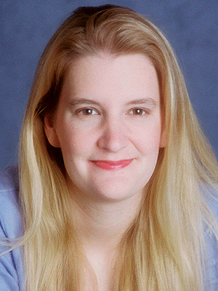
Nationally Renowned Experts
Dr. Laura Schlessinger
Dr. Jean Twenge
Aka “Dr. Laura”
National Radio Talk Show Host
Ph. D in Physiology and Family Counseling
Author of 15 books, inc The Proper Care and Feeding of Husbands
Ph. D and Professor of Psychology at San Diego State University
Author of 40 scientific articles
National media appearances
Author of Generation Me and The Narcissism Epidemic

Slide 38
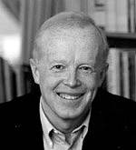
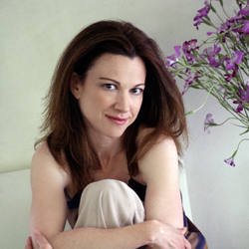
Nationally Renowned Experts
Professor David G. Myer
Author Lori Gottlieb
Author of The Pursuit of Happiness and The American Paradox: Spiritual Hunger in an Age of Plenty
Prof of Psychology at Hope College
Published in American Psychologist and Psychological Science.
Recipient of 2011 American Academy of Audiology Presidential Award
Bestselling Author of Marry Him: The Case for Settling for Mr. Good Enough
Appeared on The Today Show, Good Morning America, The Early Show, CNN, Dr. Phil, Inside Edition, Entertainment Tonight, CNBC, Oprah Radio, and NPR's "Talk of the Nation."

Slide 39
The Narcissism Epidemic in America
The aforementioned experts have written many books and done extensive research which concludes the following:
Narcissism and an over-inflated sense of entitlement have greatly eroded relationships and marriages in America, leading to high divorce rates of 50-60 percent.
Gen X and Yers are raised with excessive self-esteem “pumping”, which leads to unrealistic expectations and disappointment.
The Narcissism Epidemic has affected women far more than men. (Men are less suggestible to culture/media influence)
Women initiate the majority of divorces in America (70%), but not usually because their husbands were abusive or unfaithful, but rather, because they felt that they had “outgrown” him.

Slide 40
Why Divorce is High in America (1 of 3)
“Today’s more divorce-accepting attitudes contribute to the decline of marital satisfaction. The belief that an unrewarding marriage should be jettisoned may lead some people to invest less time in their marriages and make fewer attempts to resolve marital disagreements. Thus greater freedom to leave unsatisfying marriages may ironically increase the likelihood of marriages becoming unsatisfying. Divorce acceptance feeds marital unhappiness which feeds divorce. Americans are much less likely today than a generation ago to marry and live happily ever after. More often than not , sad to say, our initial euphoria mutates into a cold, loveless truce or worse. We should challenge radical individualism’s view that marriage is a disposable relationship.” (David G. Myer, The American Paradox, pg 45-46)

Slide 41
Why Divorce is High in America (2 of 3)
“Individualists also feel more frustration with their marriages: they criticize their partners more severely and express less marital happiness.” (David G. Myer, The American Paradox, pg 184)”
“There is evidence that women with traditional sex role attitudes are indeed less likely to divorce than those with feminists attitudes.” (David G. Myer, The American Paradox, pg 45-46)
“Now (in America) most people consider it completely acceptable to divorce if you are unhappy…” (Jean Twenge, Generation Me, pg 25)

Slide 42
Why Divorce is High in America (3 of 3)
The aforementioned expert assessments explain, at least in part, why there is such a high divorce rate in America of 50-60 percent.
Thus it is riskier to marry someone from an individualistic culture such as America.
However, Foreign women come from non-individualistic cultures where marriage is valued and they will do anything to keep the marriage together.
In the next section we will support and demonstrate this from USCIS Statistics and Surveys.

Slide 43
USCIS Statistics and Surveys (1 of 3)
20% divorce rate between American men and Foreign women vs. 50 - 60% US national divorce rate.
“It is interesting to note that, based largely on data provided by the agencies themselves (along with the Commission on Filipinos Overseas report cited above), marriages arranged through these services would appear to have a lower divorce rate than the nation as a whole, fully 80 percent of these marriages having lasted over the years for which reports are available.”
- USCIS report, Robert J. Scholes, Ph. D and Anchalee Phataralaoha, MA

Slide 44
USCIS Statistics and Surveys (2 of 3)
Foreign women are not seeking Western men for a green card or money, according to USCIS survey:
“Why do foreign women want American husbands? Many sources suggest that these women are searching for a "better life" in terms of socio-economic factors--they do, for the most part, come from places in which jobs and educational opportunities for women are scarce and wages are low. However, when the women themselves are asked this question, the answer generally indicates an attraction to American men (they look like movie stars) and an aversion to native men. Americans, they say, make good husbands while Filipino (Thai/Indonesian/Russian/etc.) men do not. Americans are thought to be faithful to their wives, while the native men are cruel and run around with other women. True or not, this is the perception.”

Slide 45
USCIS Statistics and Surveys (3 of 3)
USCIS study says most men who go abroad for love and marriage tend to be Highly Educated, Conservative, and Professionally Successful. (Not losers)
“David Jedlicka (1988, cited in Glodava and Onizuka, 1994) surveyed 607 American men seeking foreign brides and received 206 responses. He found that the men were generally white (94 percent); highly educated (50 percent with two or more years of college, 6 percent with M.D.'s or Ph.D.'s, only five did not complete high school); politically and ideologically conservative; and generally economically and professionally successful (64 percent earned more than $20,000 a year; 42 were in professional or managerial positions). Their median age was 37.”

Slide 46
Dating Imbalances in America (1 of 2)
In America, within the 25 to 40 year old age group, single men outnumber single women by 20%. Thus men are at a disadvantage and women do the choosing.
"There are actually thousands more single young men than women in America . Between the ages of 25 and 39, for every 1 unmarried woman there are 1.2 unmarried men. Even when you look only between the ages of 35 and 39, there are still thousands more unmarried men. I can hear women immediately yelling that all of the good ones are taken, but the truth is that its single men who should be anxious and complaining. Men get lonely too, though we rarely see that addressed on TV or in the movies.” (Jean Twenge, Generation Me, pg 113-114)
This imbalance is reversed overseas. In most foreign cultures, men do the choosing!

Slide 47
Dating Imbalances in America (2 of 2)
The number of men choosing overseas options for love and marriage is doubling every 7-9 years.
"The number of international marriages in the U.S. has more than doubled between 1999 and 2007.“
- Tahirih Justice Center
In fact, marriage in America is at all time lows with the latest figures showing only 51% of Americans are married. Interesting enough, there is one demographic that is bucking this trend, and that is the marriage of American/Western men to Foreign women.

Slide 48
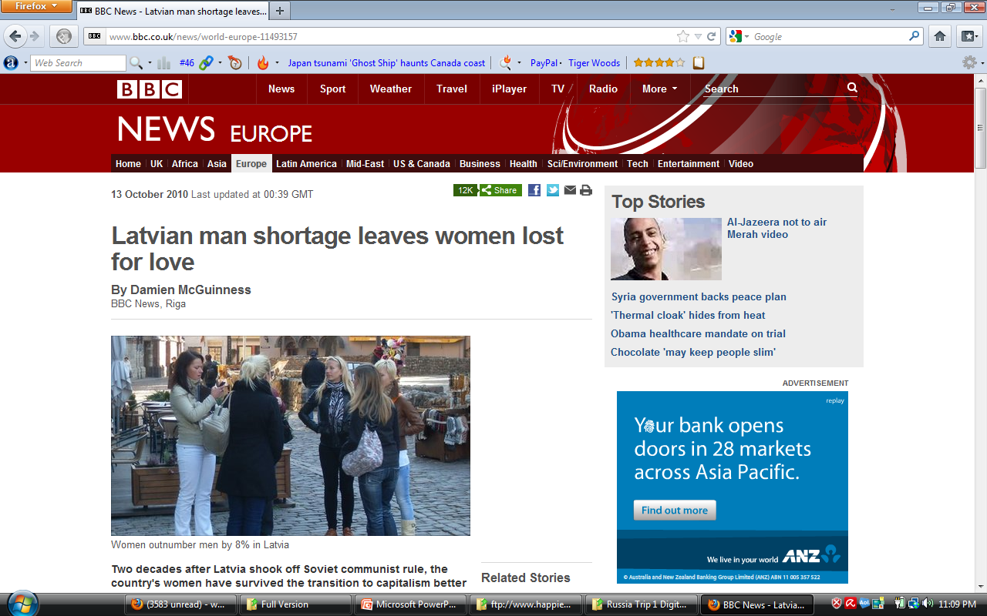
BBC article on Man Shortage in Latvia http://www.bbc.co.uk/news/world-europe-11493157
(Click image below to open link)

Slide 49
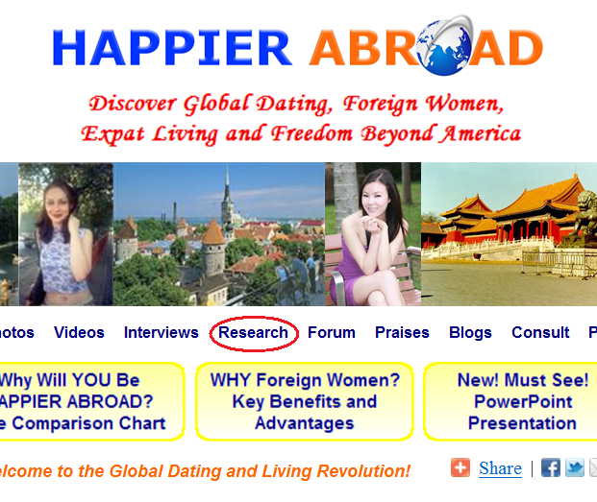
See Steve’s Research Section on HappierAbroad.com
(Click image below to go there directly)

Slide 50
“No country has it all, and most countries are heavily weighed in one direction and severely poor in another area. Countries that are materially rich are poor spiritually and socially. Countries with the best jobs opportunities cannot usually provide too many gorgeous dates. Countries with the most beautiful women have bad economies and rotten politics. It therefore stands to reason that in order to have it all, living in more than one country is often a necessity.”
- Ladislav, Chief Advisor of HappierAbroad.com

Slide 51
Conclusion (1 of 2)
Based on the evidence presented, we can logically conclude that the pursuit of international dating is a highly rational, sensible and intelligent endeavor.
While one cannot change his culture or society, one can make smart choices to find compatible partners, places and cultures for the best chances of success in love, life and happiness.
Most Western males are unaware of their international dating options and/or hold false misconceptions about them. Our mission is to spread awareness among them.

Slide 52
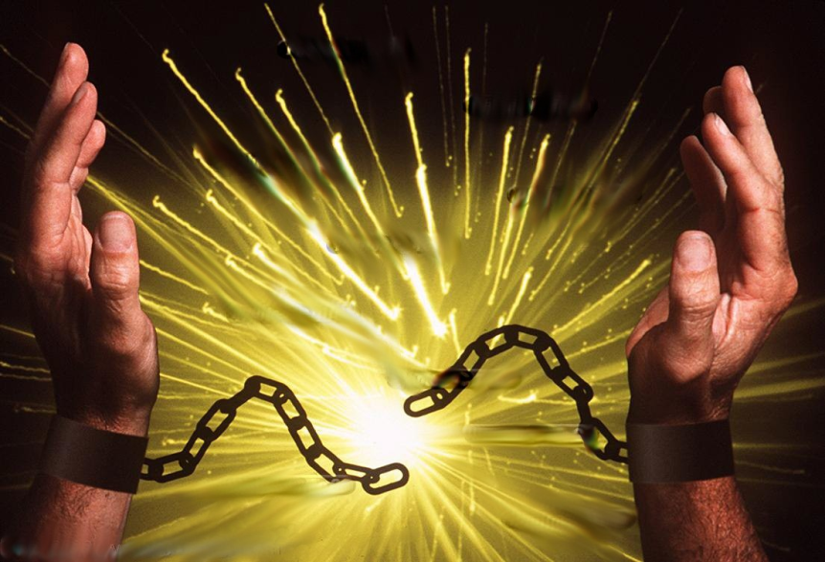

Conclusion (2 of 2)
The first step in this journey is Mental Liberation. One must stop living in fear and worrying about what others will think of their unconventional choices. Only then will one be free to allow new possibilities for love, success and happiness across borders without regrets.

Slide 53
Thank you for viewing our Presentation
To learn more, visit www.HappierAbroad.com
Click here to go there directly
Pass this Presentation along by sharing the download link

