Slide 1
Jane Eyre
The (Female) Bildungsroman

Slide 2
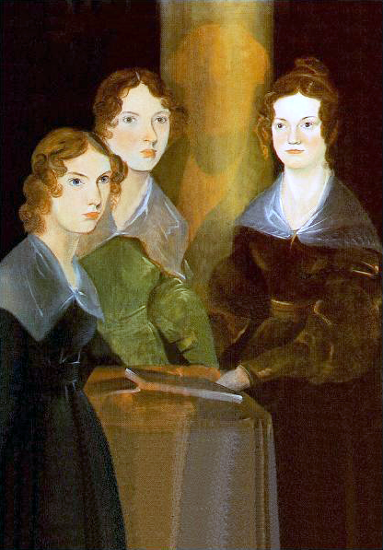
The Bronte Sisters: Anne, Emily, Charlotte (c. 1834, painted by Branwell)
Notes:
English: A painting of the three Brontë sisters; from left to right, Anne, Emily, and Charlotte. In the center of portrait is the shadow of Branwell Brontë, the artist, who painted himself out.
ca. 1834

Slide 3
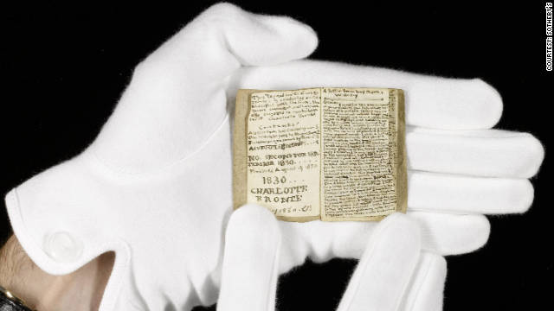
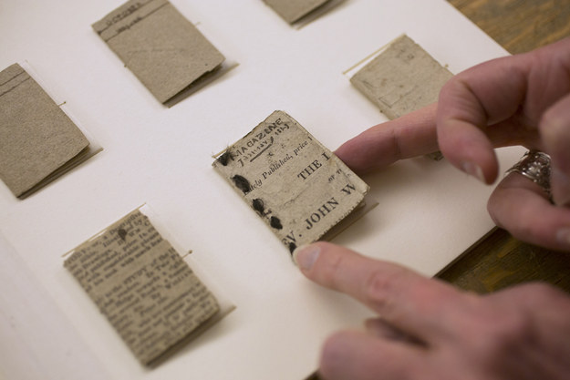

Slide 4
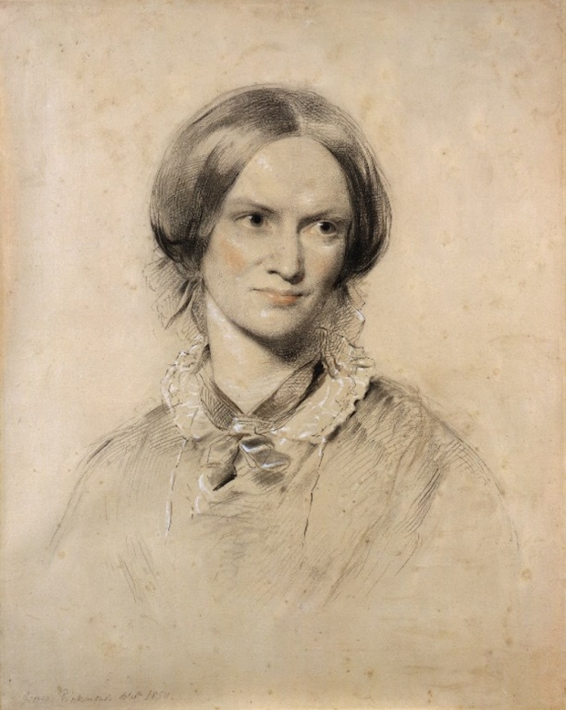
Charlotte Bronte, b. 1816, Thornton, Yorkshire. Born third oldest; older sisters Elizabeth and Maria died after falling ill in boarding school. Charlotte was then oldest, siblings were: Emily, Branwell, and Anne. CB died 1854. outliving all siblings. Shirley (1849) and Villette (1853) published under pseudonym: CURRER BELL. [Emily was ELLIS BELL, Anne was ACTON BELL]

Slide 5
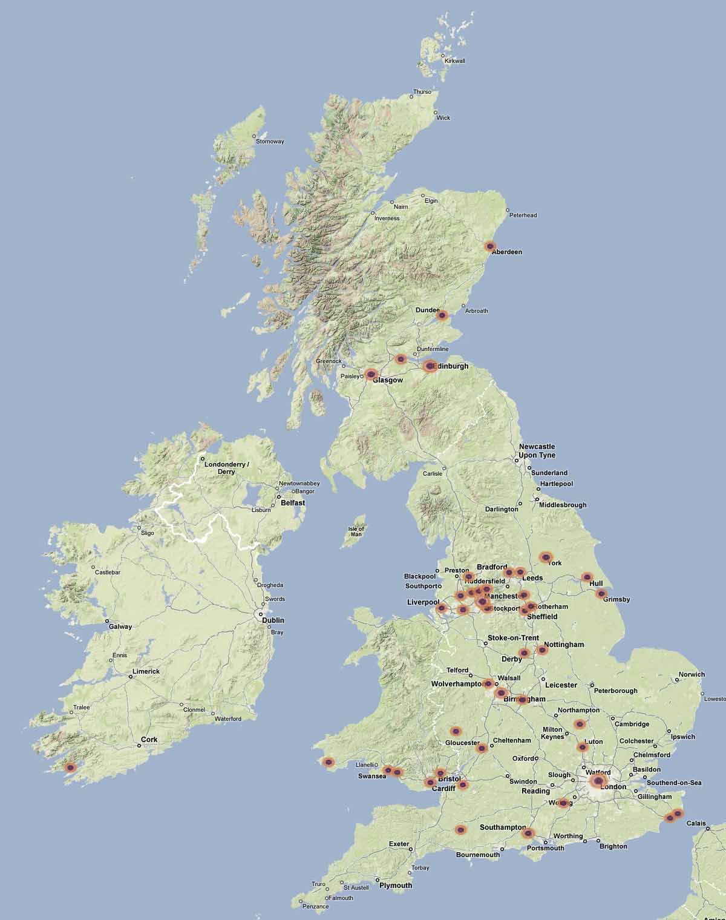

Slide 6


Slide 7
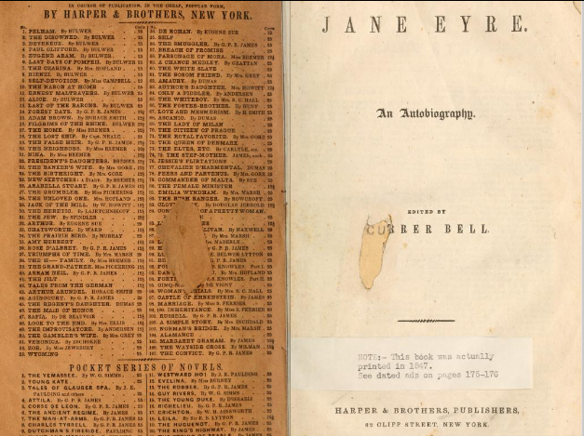

Slide 8
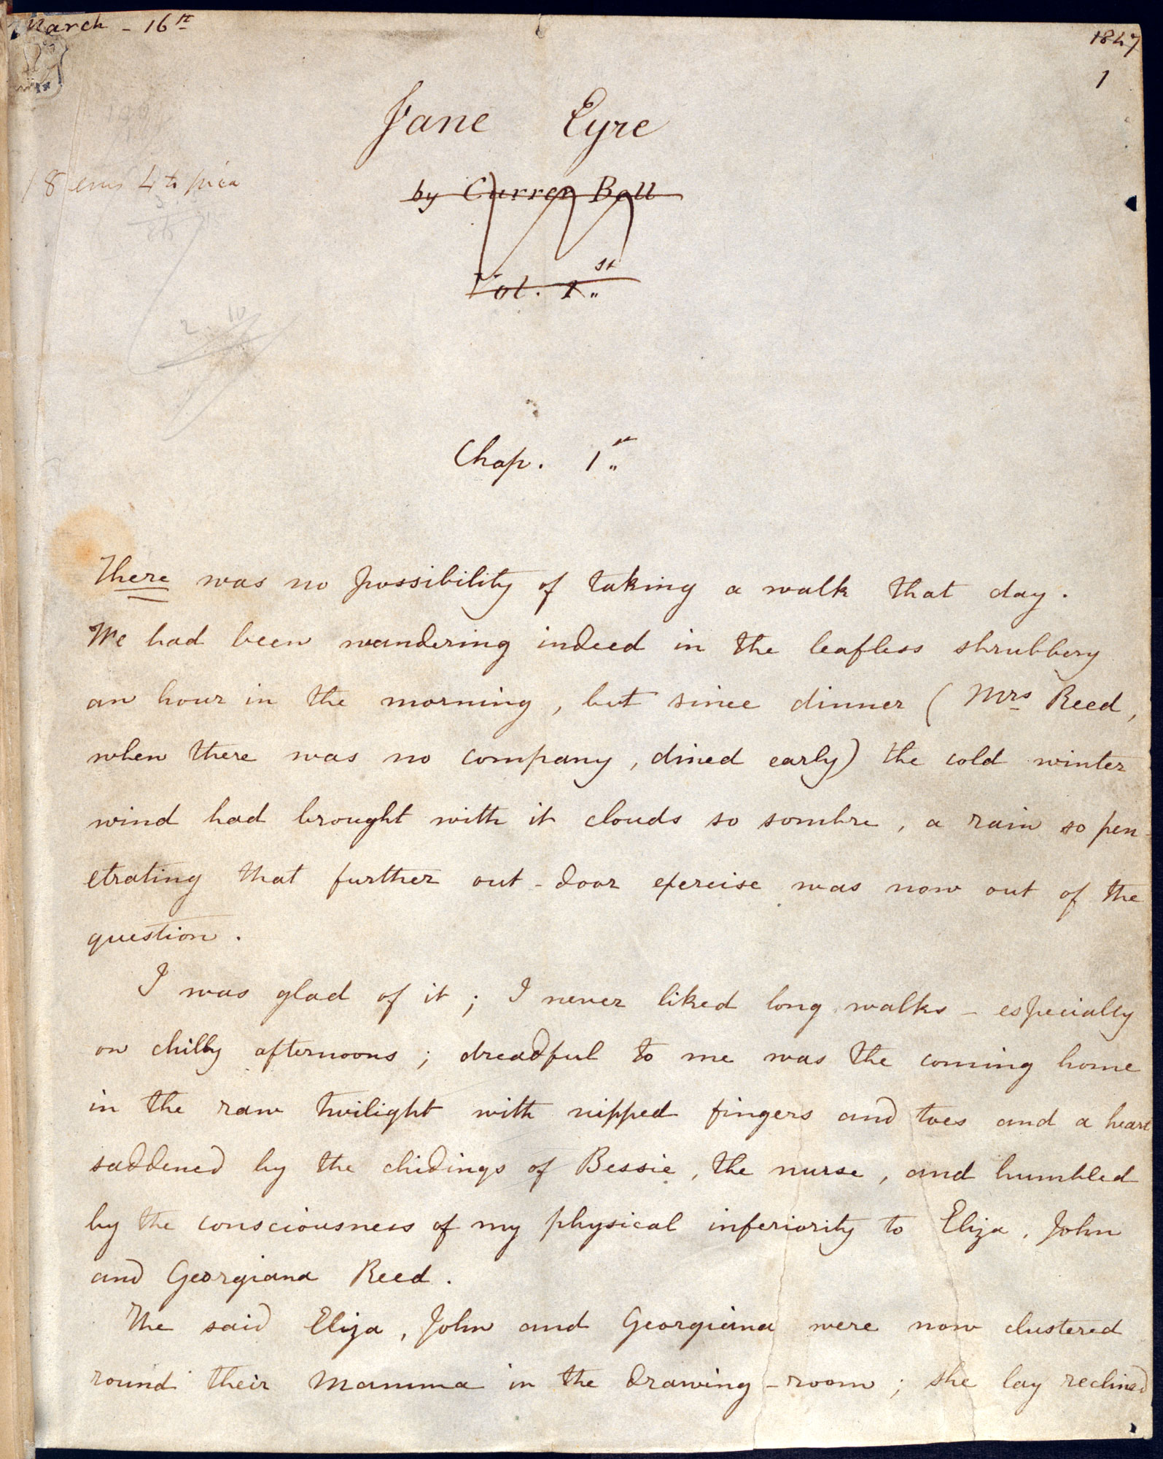

Slide 9
Textual History
Begun August 1846, in northern industrial town of Manchester
Completed August 19, 1847;
Published October 19, 1847, as “An Autobiography. Edited by…. Currer Bell.”
Second, third editions said: “An Autobiography, by Currer Bell”
What is this genre?

Slide 10
What is bildung? What is a bildungsroman?
Bildung (a German word whose meanings include education and forming) refers to the German tradition of self-cultivation (as related to the German for: creation, image, shape), wherein philosophy and education are linked in a manner that refers to a process of both personal and cultural maturation. This maturation is described as a harmonization of the individual’s mind and heart and in a unification of selfhood and identity within the broader society, as evidenced with the literary tradition of Bildungsroman.
Source: Wikipedia; please see Moretti handout for thicker detail!

Slide 11
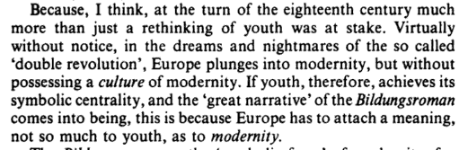
Franco Moretti, The Way of the World: The Bildungsroman in European Culture (1987): 5.

Slide 12
Mill’s Myth of Modernity
“In the part [of conduct] which merely concerns himself, his independence is, of right, absolute. Over himself, over his own mind and body, the individual is sovereign” (On Liberty 13)

Slide 13
Desire, blockage, resistance, formation
Rat, mad cat, toad, others?
Strange, roving, solitary, queer, frightened, shy, little, sharp, venturesome, hardy (all from Bessie, 47)
Food!?
Slavery, liberty, detention
“roving, venturesome”: MOBILITY

Slide 14
Location, advancement?
Gateshead
Lowood
?

